Slide 1

The Stables
Meadow Nursery Lodge Doxford Park
Sunderland
Tyne and Wear
SR3 2PE
Tel: 07591207750
Email: karl@cmscic.co.uk Company Reg. No. 10085926
“Increasing Biodiversity through Grounds Maintenance”
“Over the last century human activity has caused the disappearance of many wildlife habitats. Both nature reserves and urban green spaces have an important role to play in improving and maintaining biodiversity and important ecosystem services”

Slide 2
The Stables
Meadow Nursery Lodge Doxford Park
Sunderland
Tyne and Wear
SR3 2PE
Tel: 07591207750
Email: karl@cmscic.co.uk Company Reg. No. 10085926
‘Wildlife Friendly’ Grounds Maintenance
Following an ecological timeline
Notes:
Right work in the right season. Survey fields, hedges and trees before any work. Following an ecological timeline

Slide 3


The Stables
Meadow Nursery Lodge Doxford Park
Sunderland
Tyne and Wear
SR3 2PE
Tel: 07591207750
Email: karl@cmscic.co.uk Company Reg. No. 10085926
‘Wildlife Friendly’ Grounds Maintenance
Right work in the right season
Notes:
Right work in the right season. Survey fields, hedges and trees before any work. Following an ecological timeline

Slide 4


The Stables
Meadow Nursery Lodge Doxford Park
Sunderland
Tyne and Wear
SR3 2PE
Tel: 07591207750
Email: karl@cmscic.co.uk Company Reg. No. 10085926
‘Wildlife Friendly’ Grounds Maintenance
Right work in the right season
Survey Fields, hedges and trees
Notes:
Right work in the right season. Survey fields, hedges and trees before any work. Following an ecological timeline

Slide 5
School contracts
Annual maintenance contracts
on new developments
Landscaping, fencing and garden services
to residential customers
Environmental projects with Local Authority and Partners
Notes:
Right work in the right season. Survey fields, hedges and trees before any work. Following an ecological timeline

Slide 6
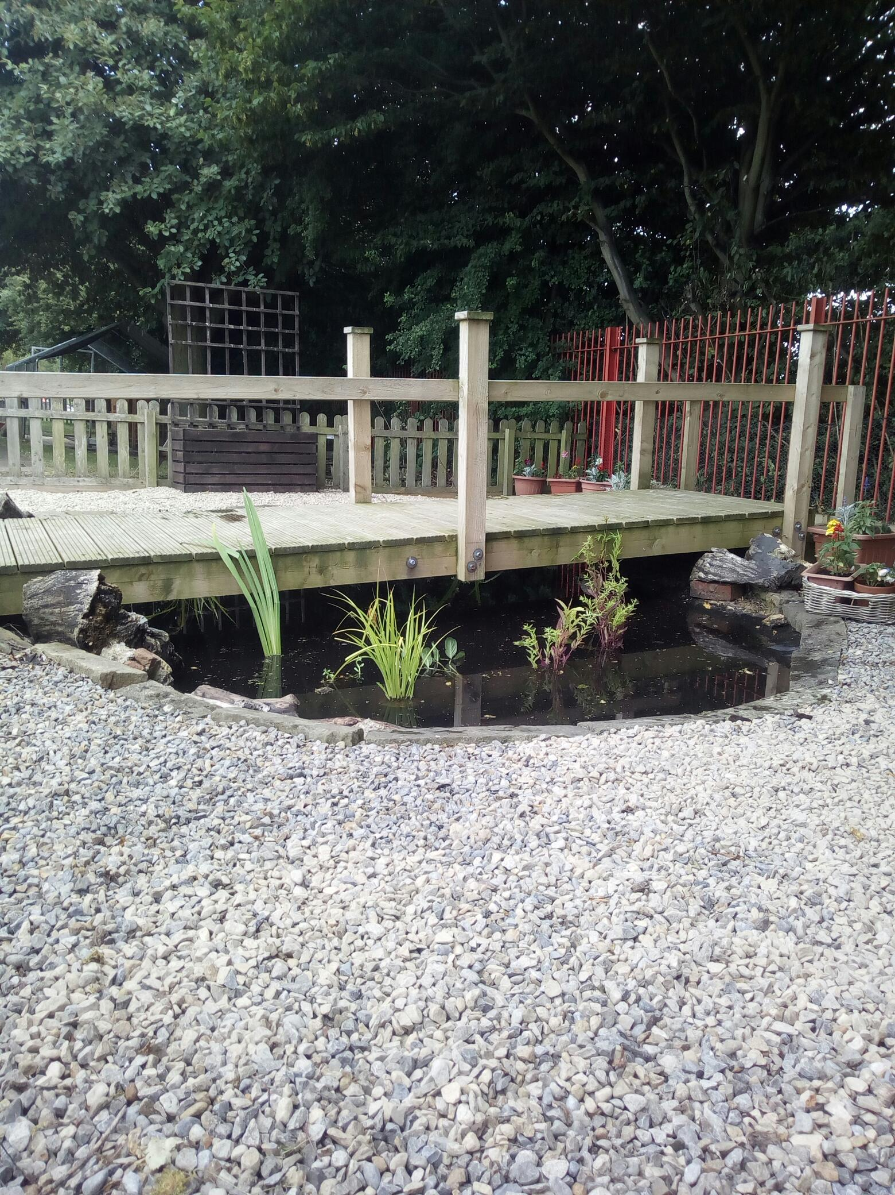
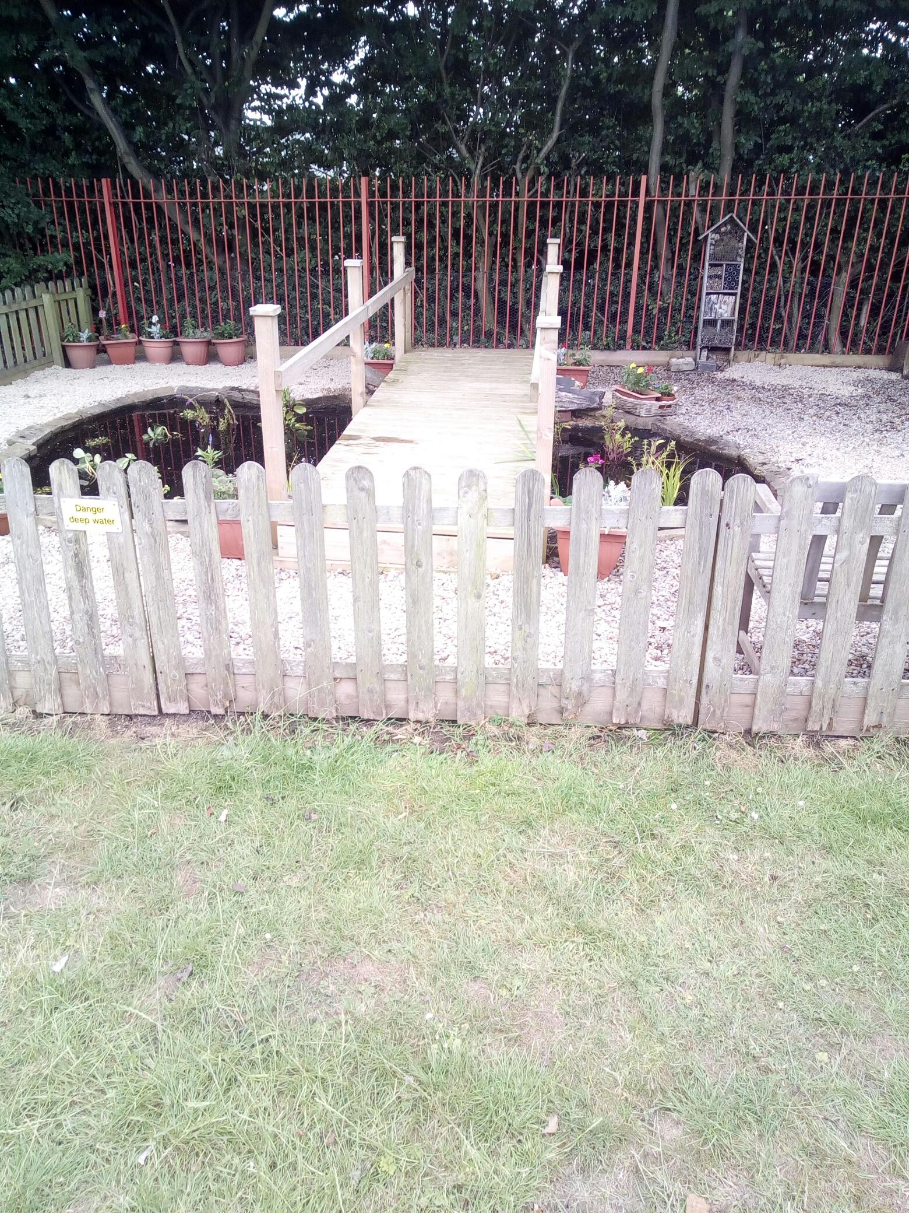
Notes:
Right work in the right season. Survey fields, hedges and trees before any work. Following an ecological timeline

Slide 7
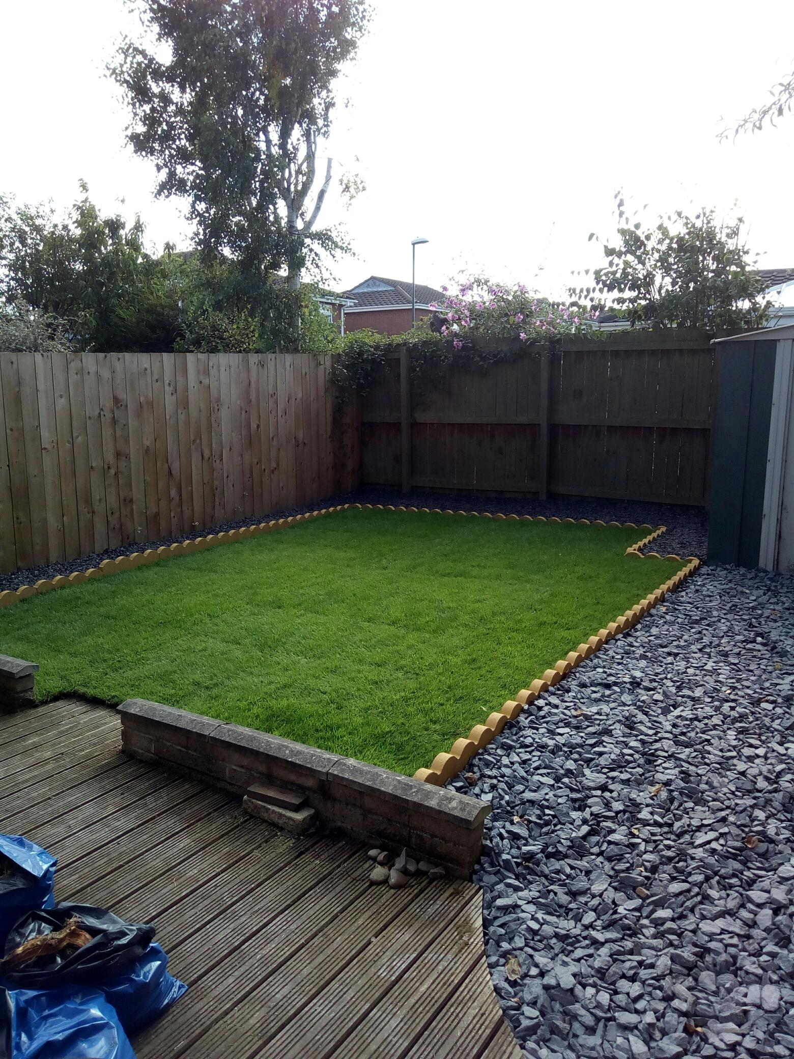
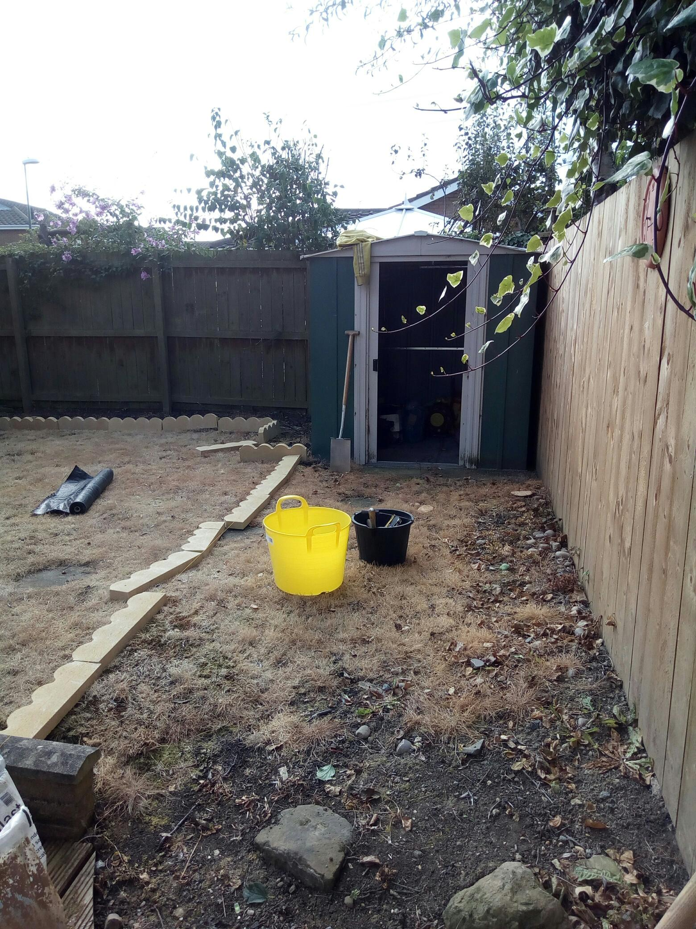
Landscaping, fencing and garden services
to residential customers
Notes:
Right work in the right season. Survey fields, hedges and trees before any work. Following an ecological timeline

Slide 8
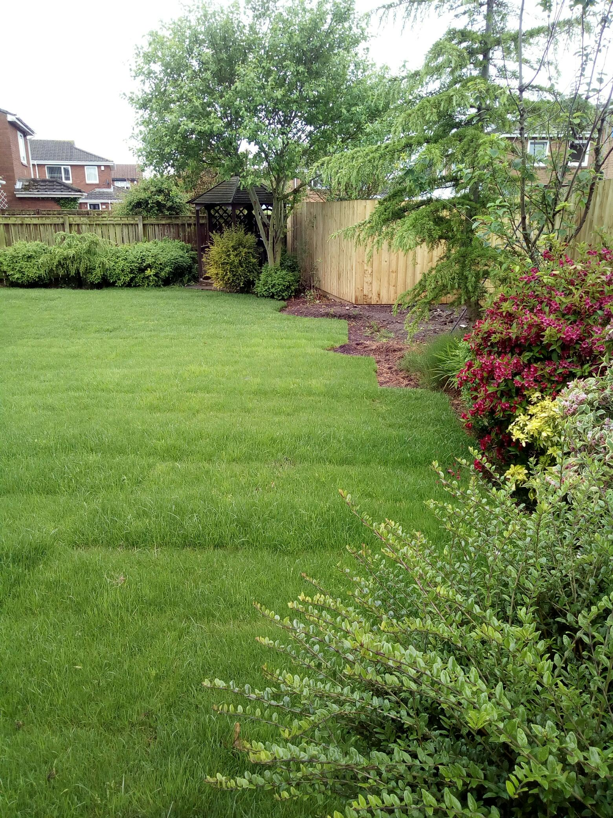
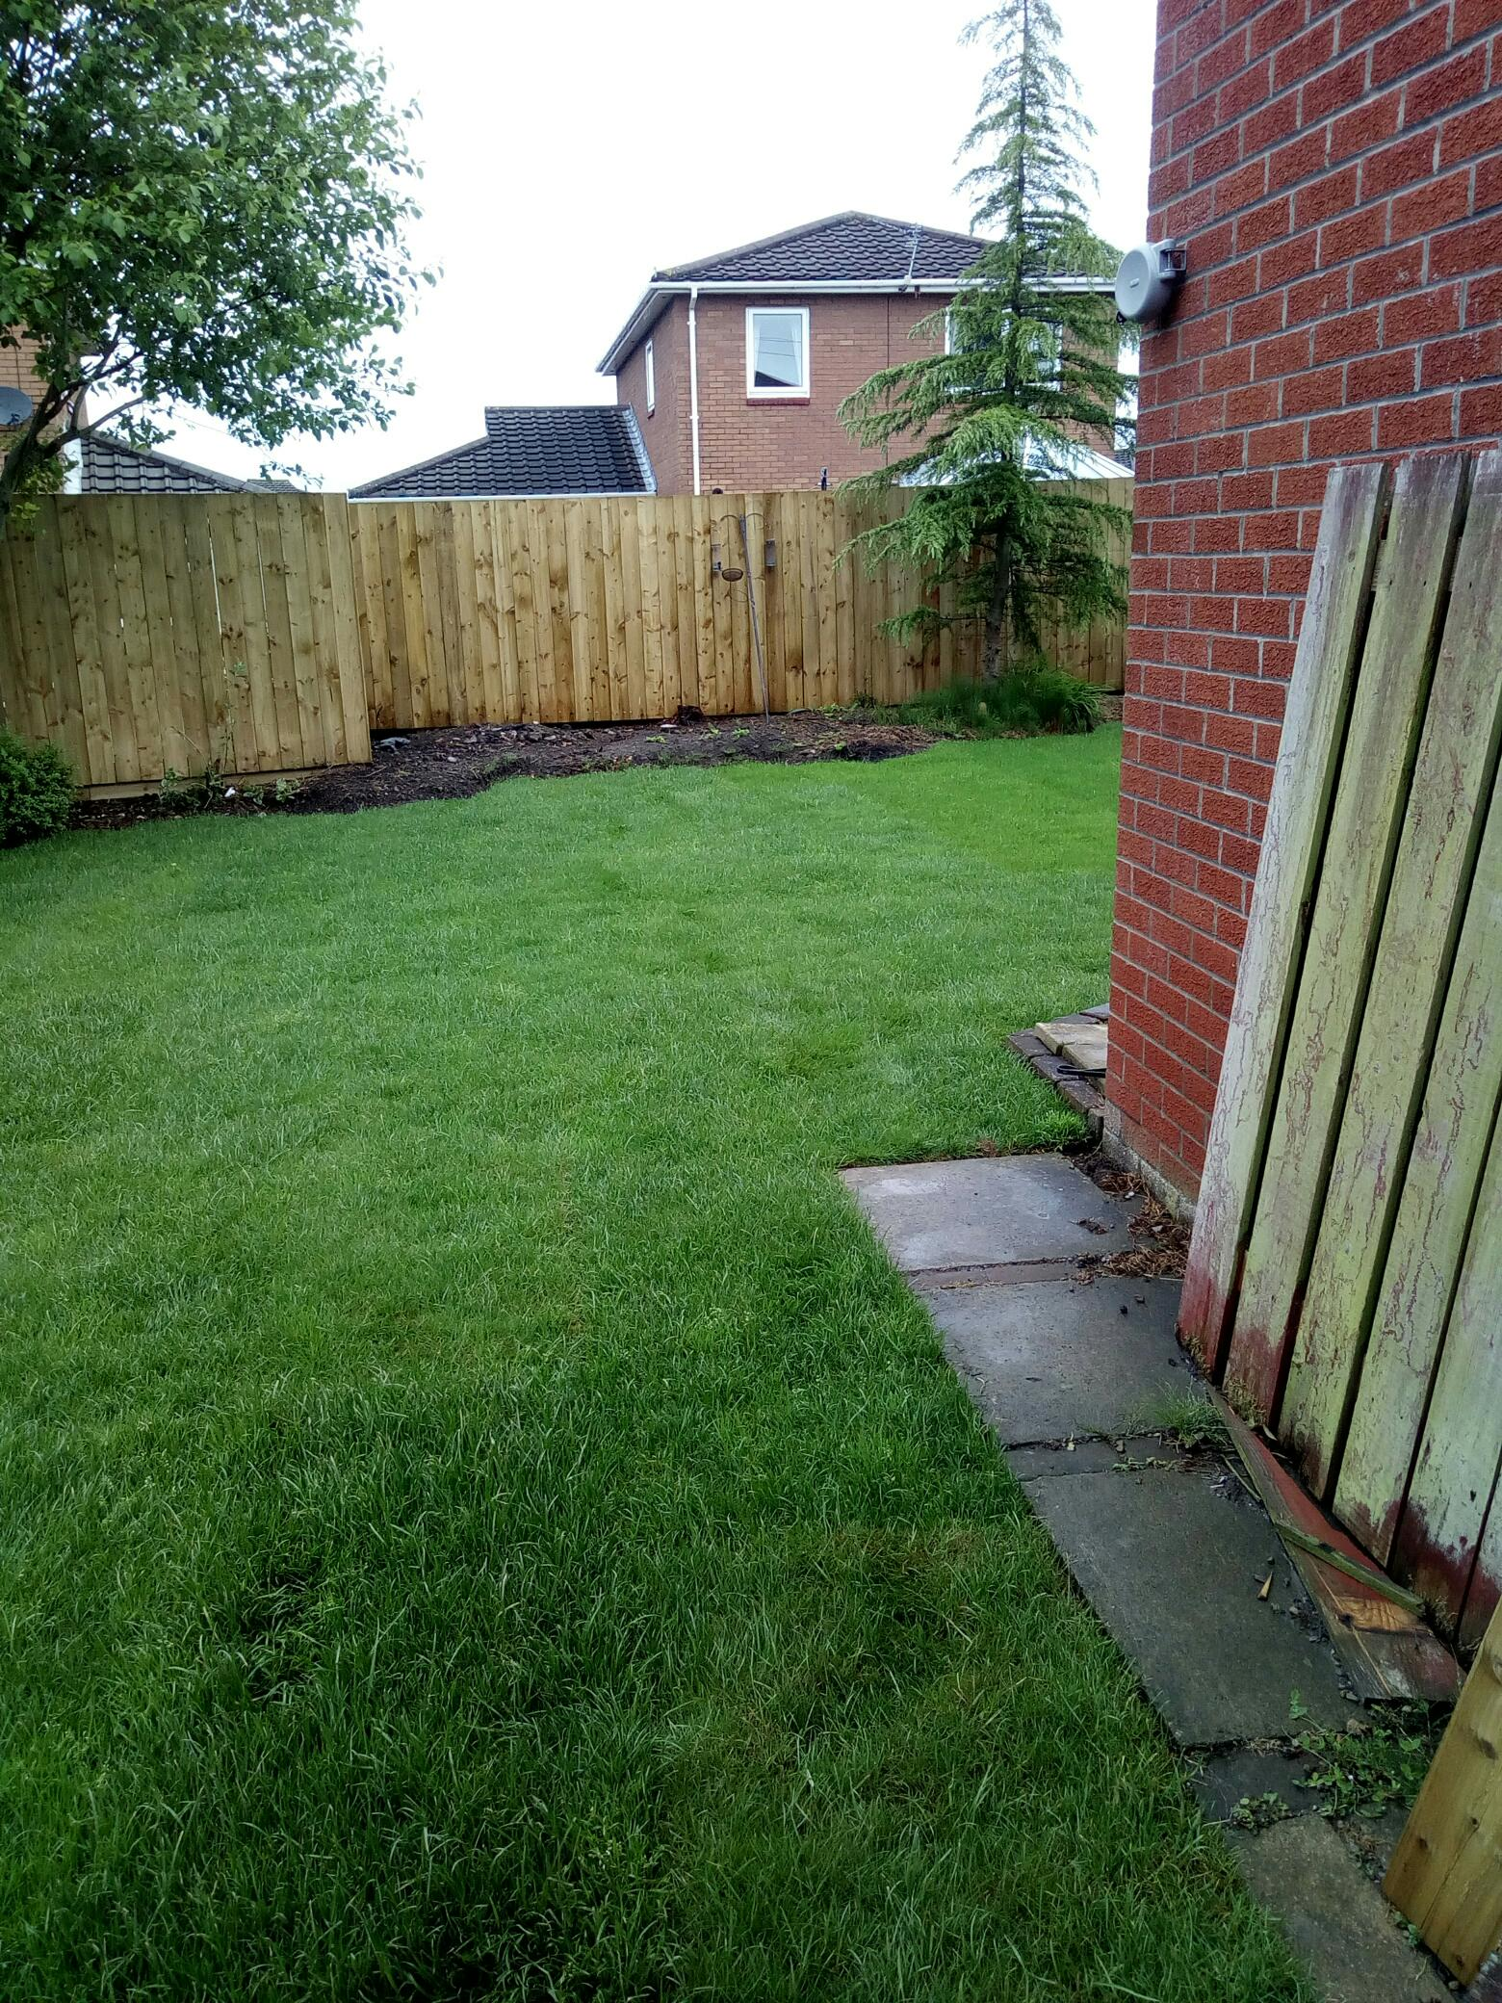
Notes:
Right work in the right season. Survey fields, hedges and trees before any work. Following an ecological timeline

Slide 9

Think Big Act Local! 2018
Forest School activities
Doxford in Bloom
Landscaping and environmental improvements to Doxford Park
..including new Woodland Trail and 100 trees planted
Willow Coppice
Hazel Coppice
Notes:
Right work in the right season. Survey fields, hedges and trees before any work. Following an ecological timeline

Slide 10
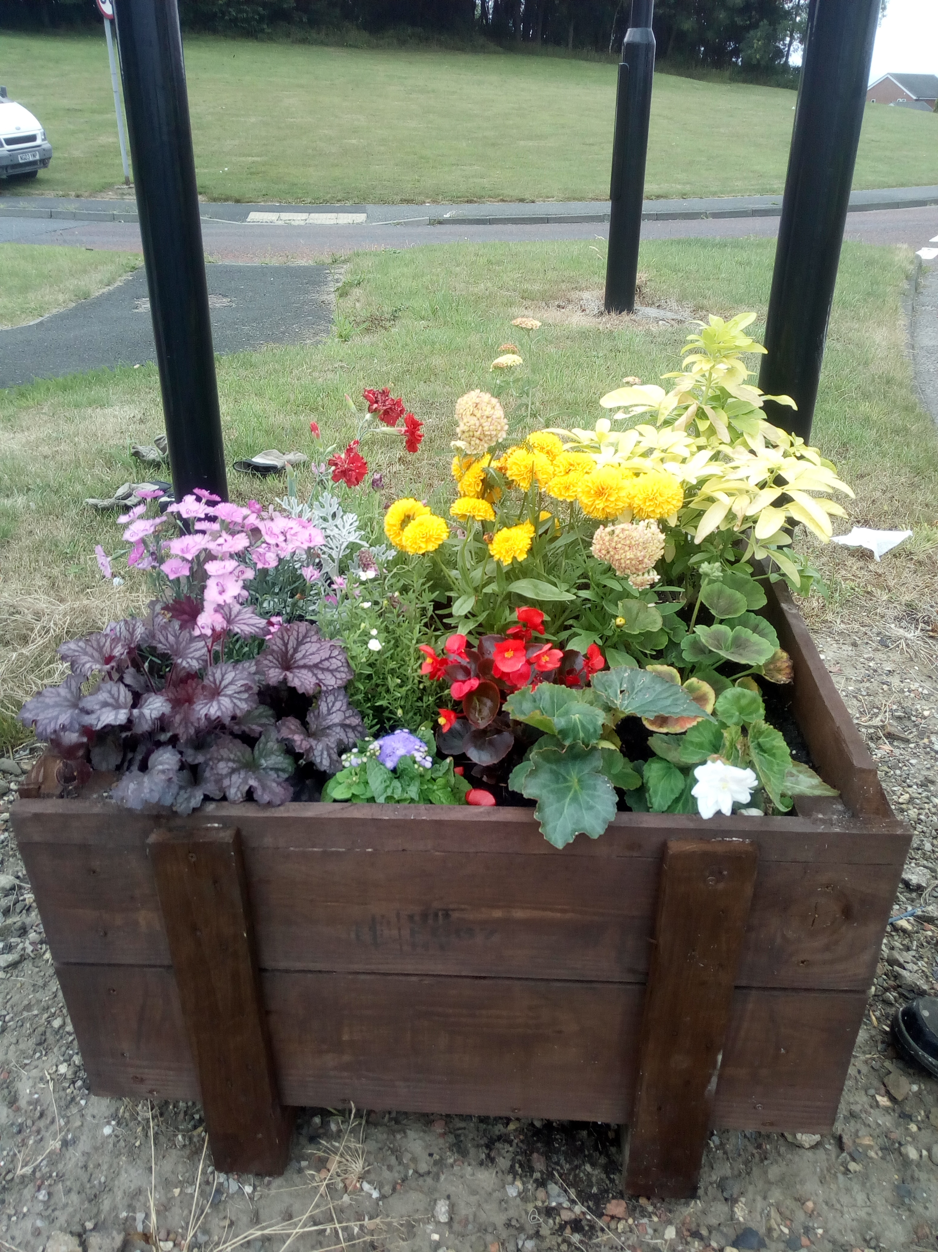
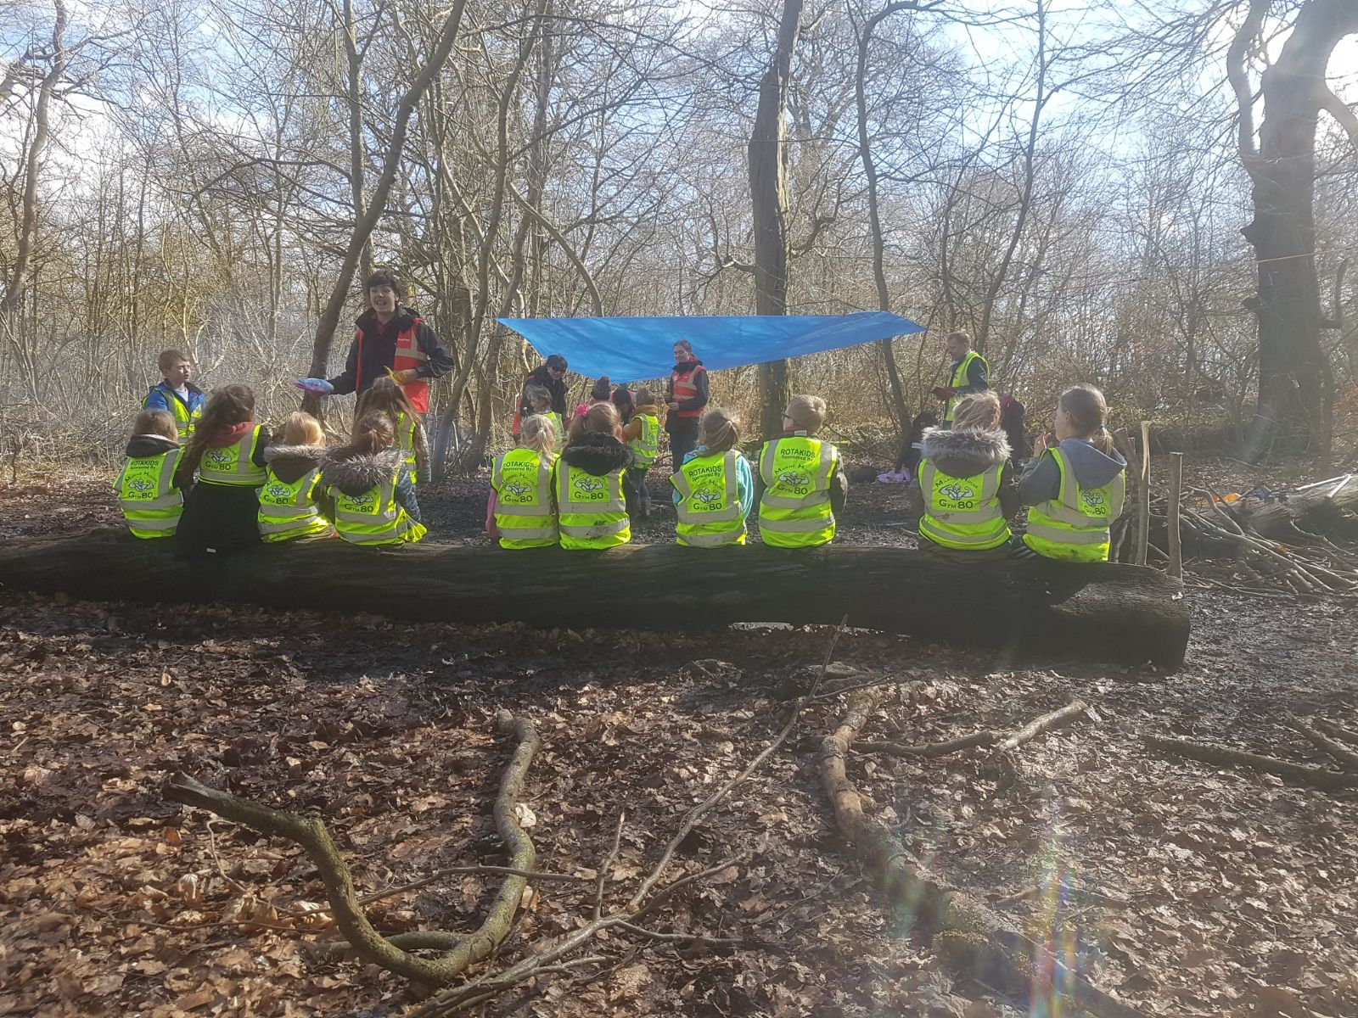
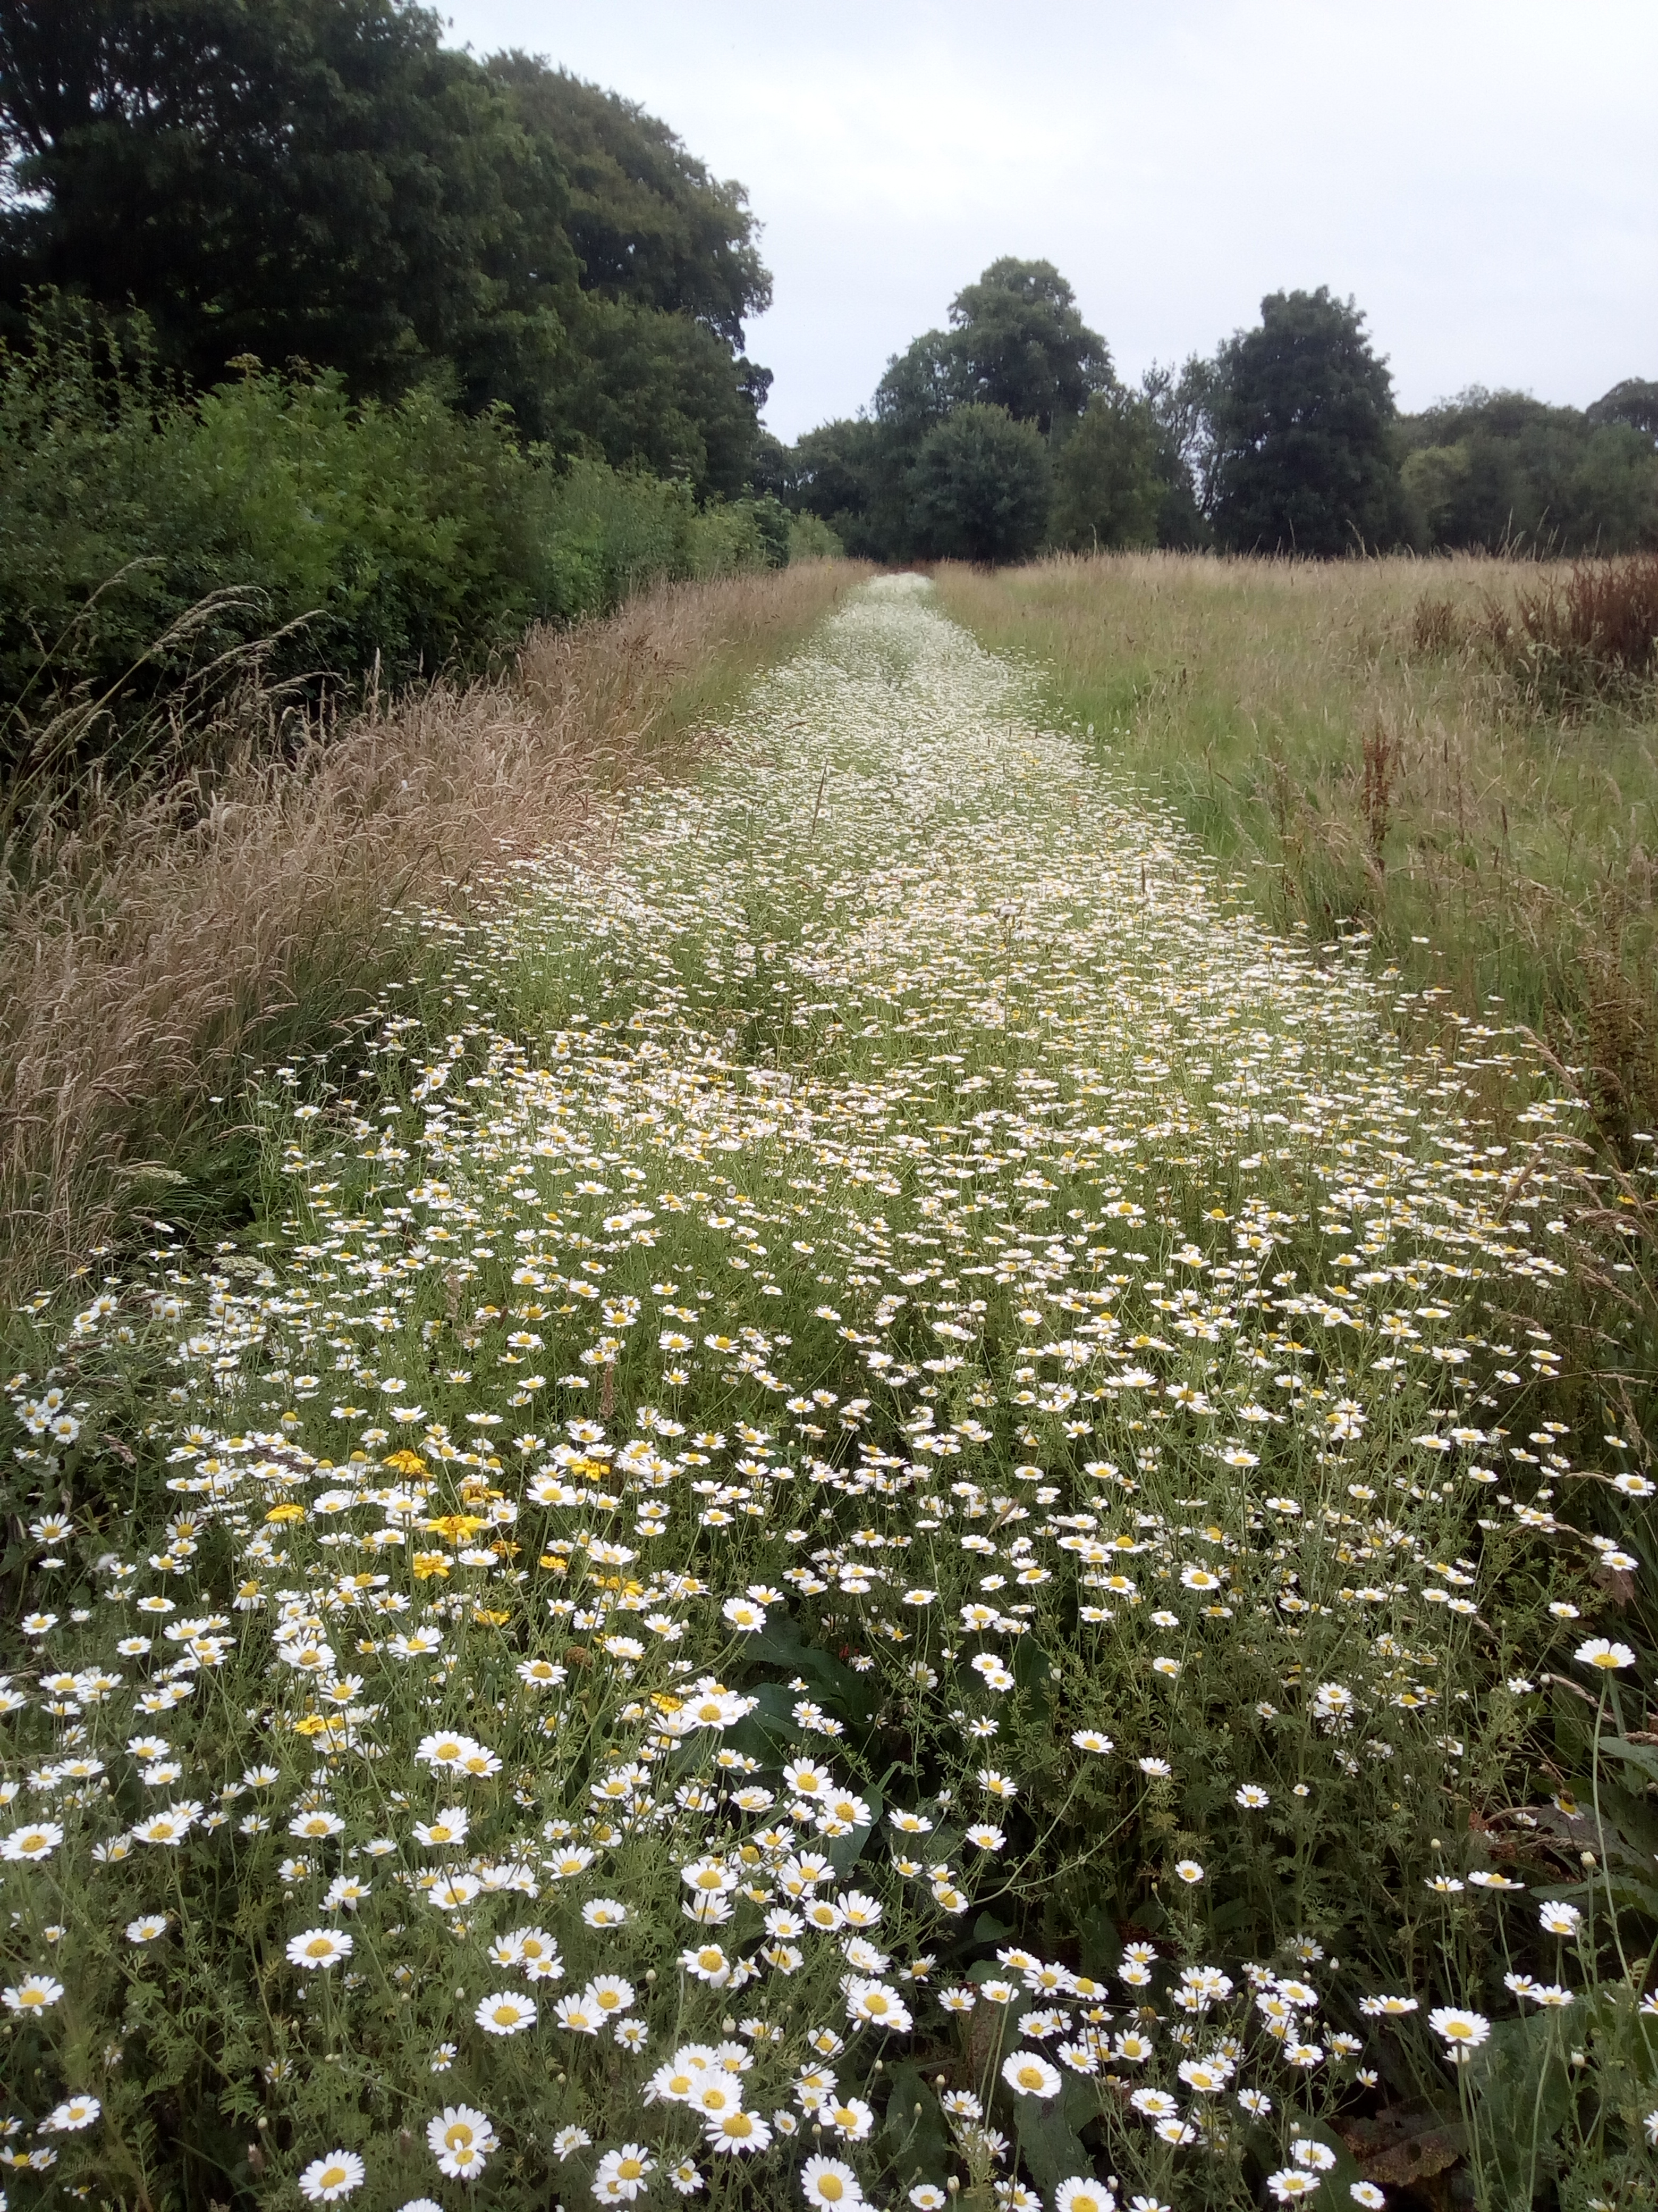
Think Big Act Local! 2018
Doxford in Bloom
Forest School activities
Landscaping and environmental improvements to Doxford Park
Notes:
Right work in the right season. Survey fields, hedges and trees before any work. Following an ecological timeline

Slide 11
The Stables
Meadow Nursery Lodge Doxford Park
Sunderland
Tyne and Wear
SR3 2PE
Tel: 07591207750
Email: karl@cmscic.co.uk Company Reg. No. 10085926
“Increasing Biodiversity through Grounds Maintenance”

Slide 12


EAST RANGERS PROJECT
“Increasing Biodiversity through Grounds Maintenance”

Slide 13
EAST RANGERS PROJECT
Roles of a Ranger could include: Planting, clearing streams, raking, cutting and clearing vegetation and grass, access work, tree and shrub pruning, litter picking and recording and increasing biodiversity where possible.
Notes:
Including training in identifying INNS and biosecurity measures

Slide 14
Phase 1
(with match funding from SCC)
20 local people ( Volunteers ) from the EAST Ward but including staff from lead partner organisations
Accredited training in the use of Equipment
Grounds Maintenance training

Slide 15
Training to include:
Brushcutter/Strimmer
Pedestrian Mower
Hedge Cutter
Weed Ripper
Register of Land Operatives Qualification (ROLO)
CSCS Card
Notes:
Full year round HSE accredited certifications. New skills, increased employment opportunties

Slide 16
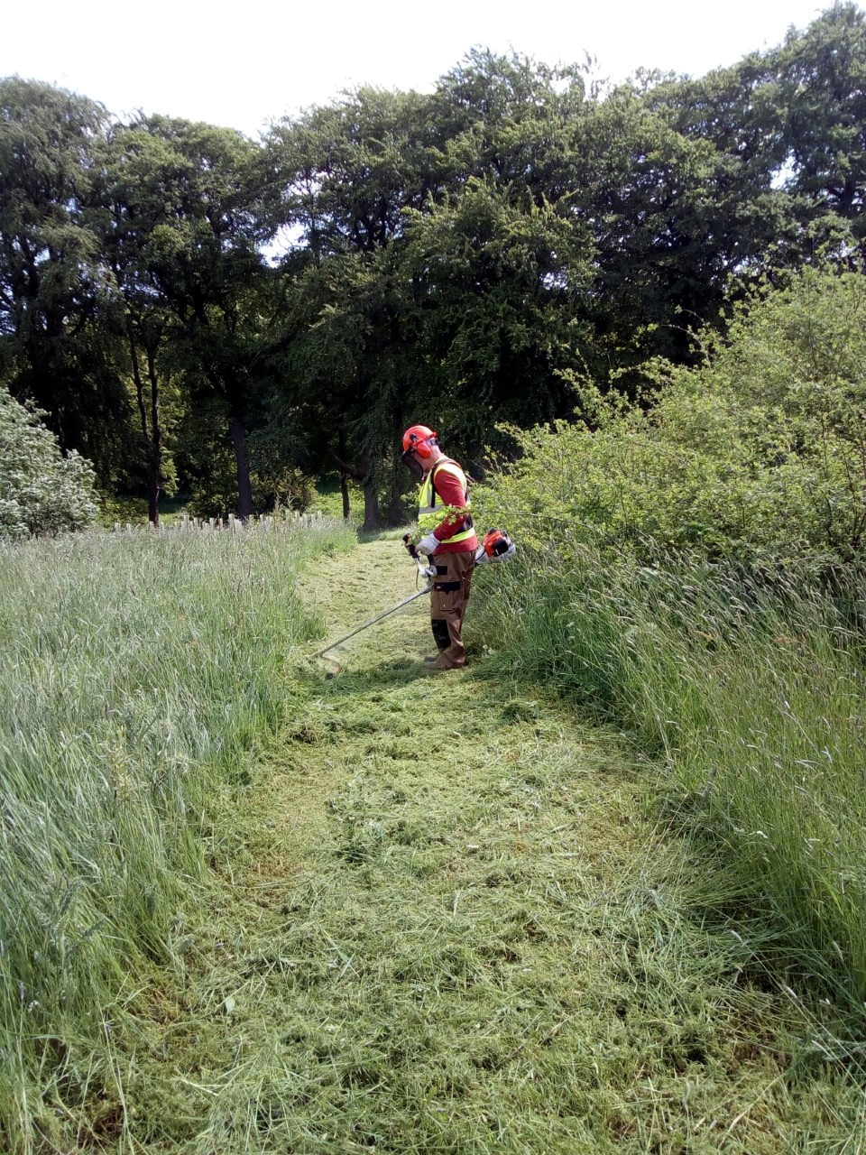
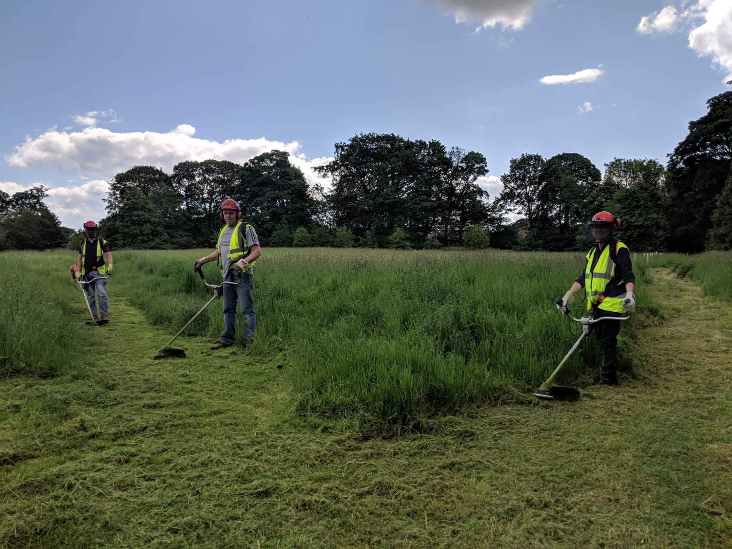
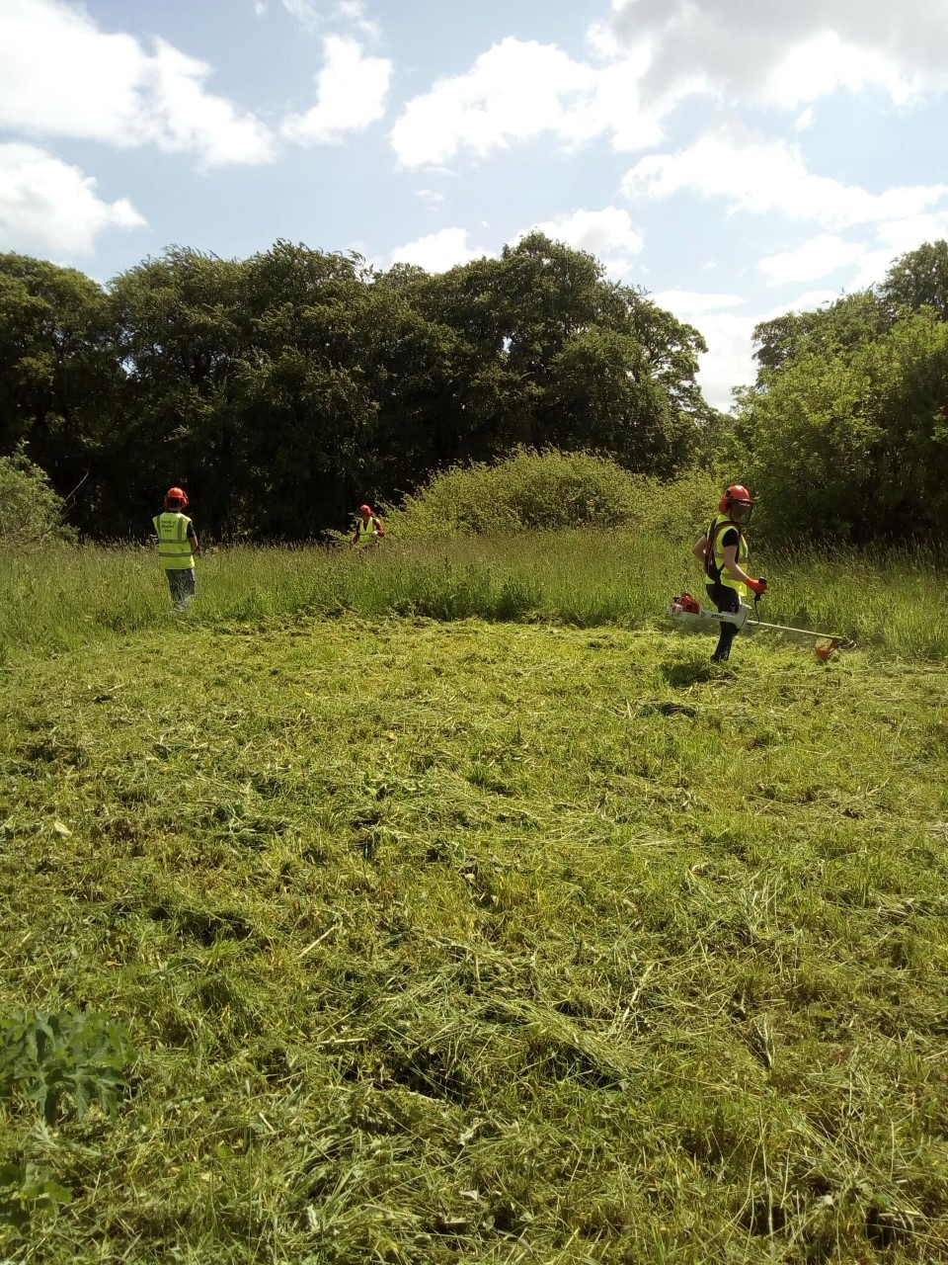
Rangers gaining experience and confidence using the Stihl brushcutter/Strimmers in Doxford Park
Notes:
A relatively small investment when SROI is assessed.

Slide 17





PHASE 2
(Deployment)
Notes:
The Partners

Slide 18
Each partner works 4 hours a week with 4 or 5 volunteers
1 day of the week for 40 weeks
Added Value!

Slide 19
Phase 2 funded by SIB
Extension of Cleaner Communities
Volunteers bored of litter picks

Slide 20
Senior Site Supervisor Neale Brown
Oversee equipment, Rangers and manage Risks
Employed through SIB as part of Phase2

Slide 21
Ranger Project as Match Funding for Pocket Park Bid

Slide 22
Pocket Park Bid - £25k
2 Outdoor Education/Forest School areas
Educational Trail
Trees
Wildflower plug plants
Willow Bird Hide/Screen

Slide 23
The Stables
Meadow Nursery Lodge Doxford Park
Sunderland
Tyne and Wear
SR3 2PE
Tel: 07591207750
Email: karl@cmscic.co.uk Company Reg. No. 10085926
“Increasing Biodiversity through Grounds Maintenance”

