Slide 1
Climate Action North
Community Interest Company

Slide 2
“Inspiring and igniting action on Climate Change across the North East”
Climate Action North

Slide 3
Who are We
Sharon Lashley Managing Director
Jennifer Clair Robson Director

Slide 4
What we do
Maiden Wild
6 acre plot
Rewilding & Climate Action Hub
Pollinator Parks
Green Heart Initiative
Projects for schools & communities
Climate Action Toolkit
Launch due for December 2019

Slide 5
What we do
Events
World Environment Day
Annual Conferences 5th
June
Rewilding Series of Events
Partnership Events
Projects/Initiatives
Green Heart – initiative
includes projects
Business Resilience Toolkit
Pollinator Parks – Rewilding
Businesses
Maiden Wild – 6 acre plot,
rewilding/climate action hub

Slide 6
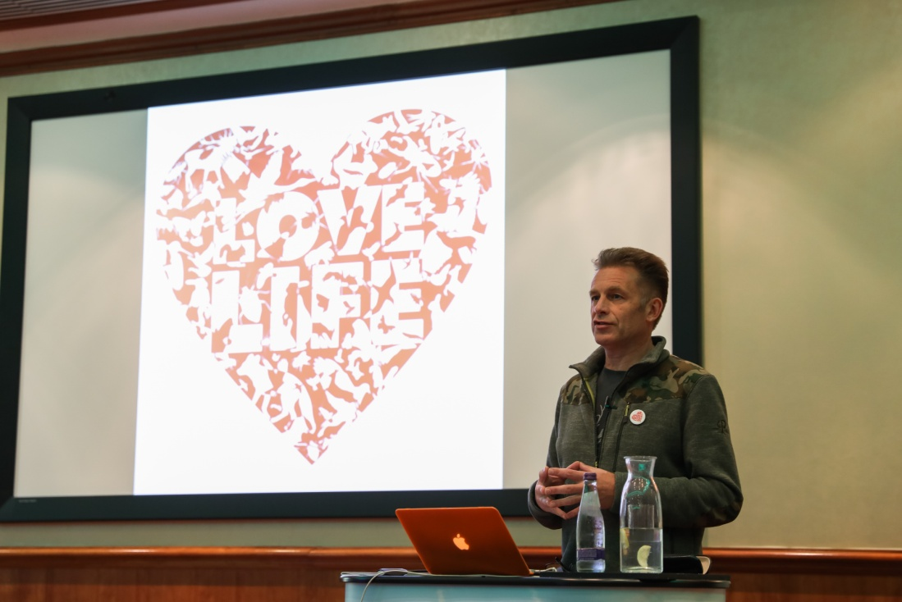
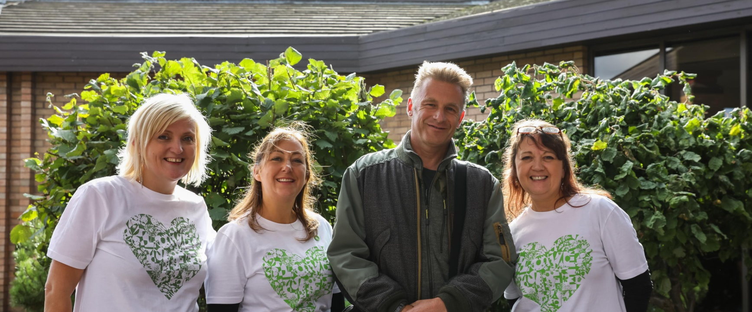
Events & Conferences

Slide 7
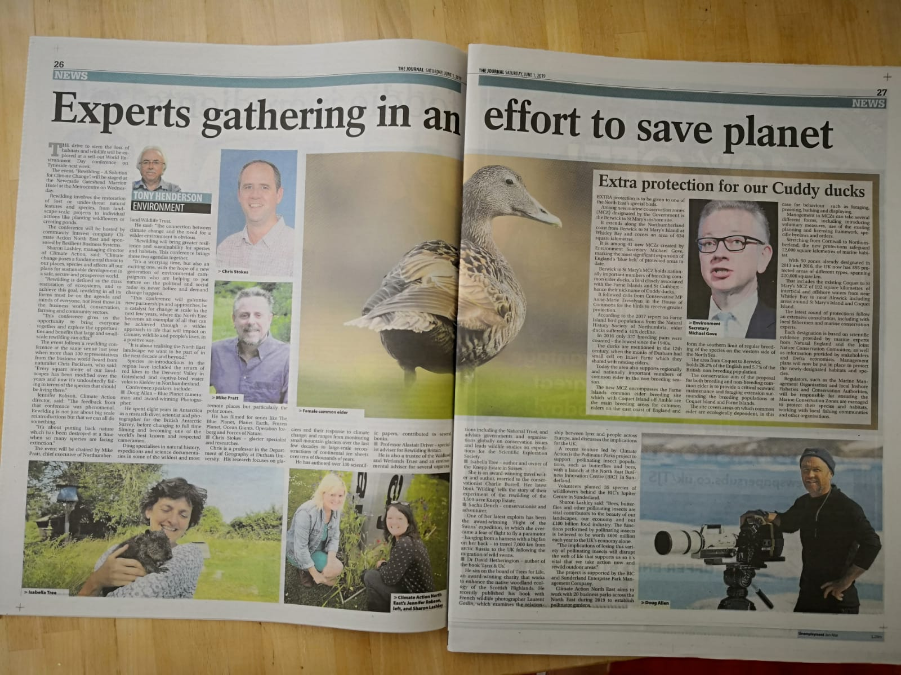
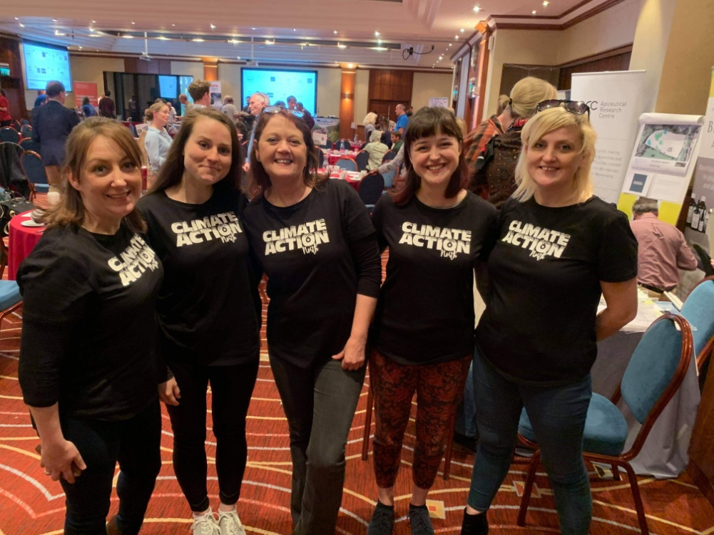
Events & Conferences

Slide 8
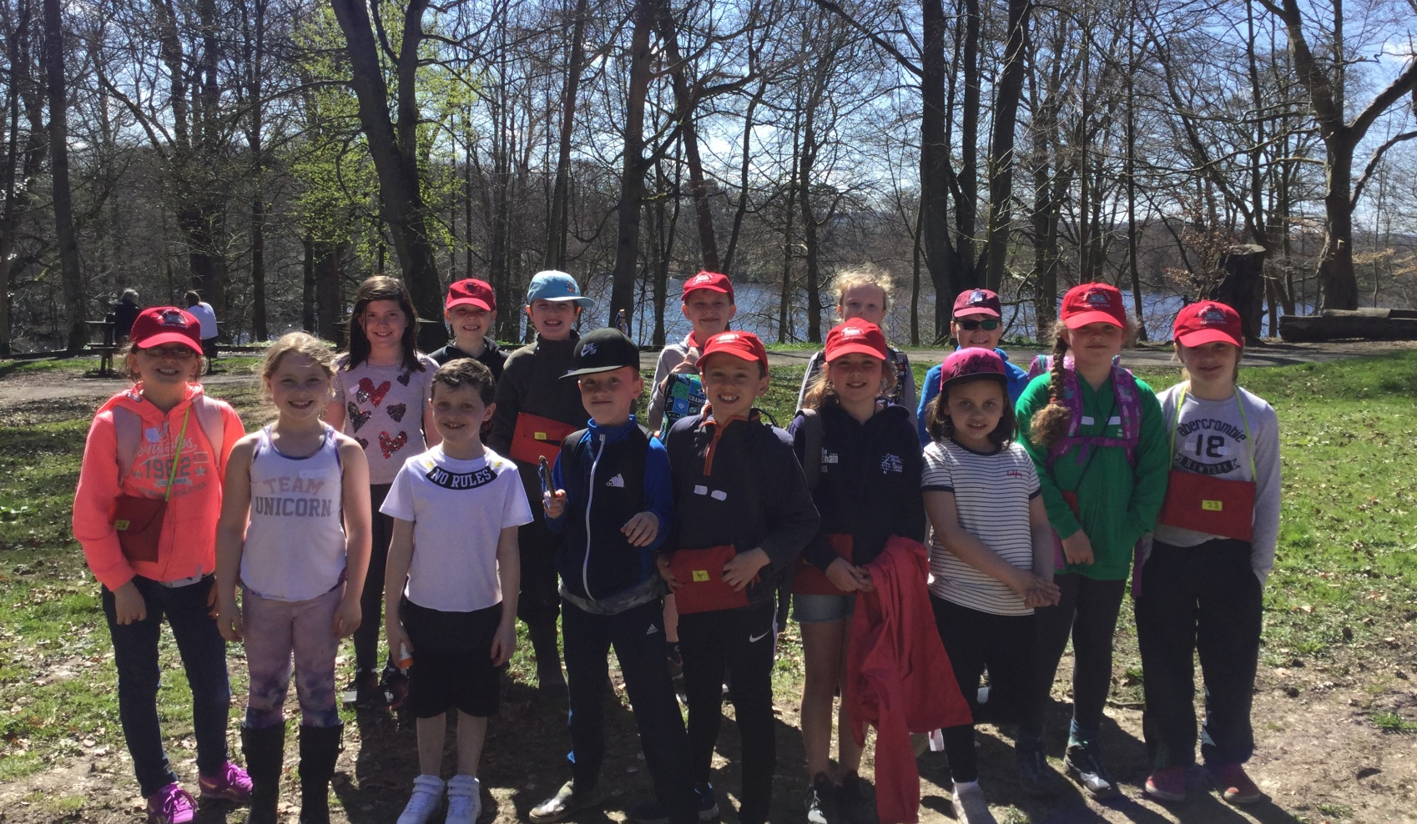
Green Heart Initiative
Whalton School – Northumberland
Earth Magic Project – Earth Magicians
Beach Carers
Mini Rewilders
Climate Keepers

Slide 9
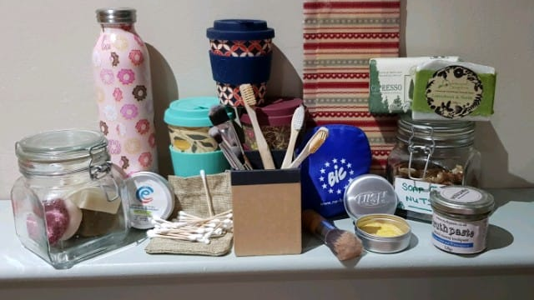
Single Use Plastic Free - Awareness Raising

Slide 10
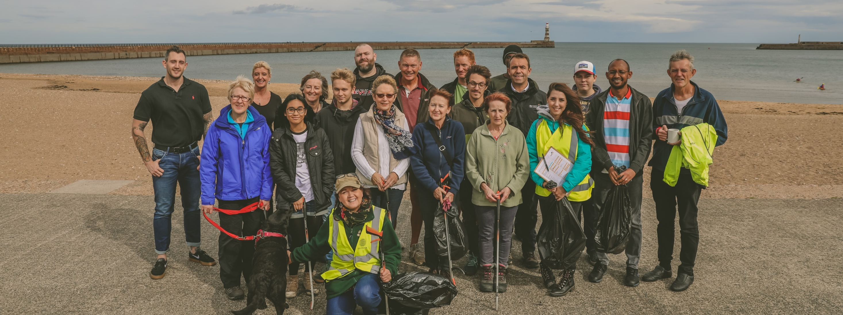
Beach Cleans

Slide 11
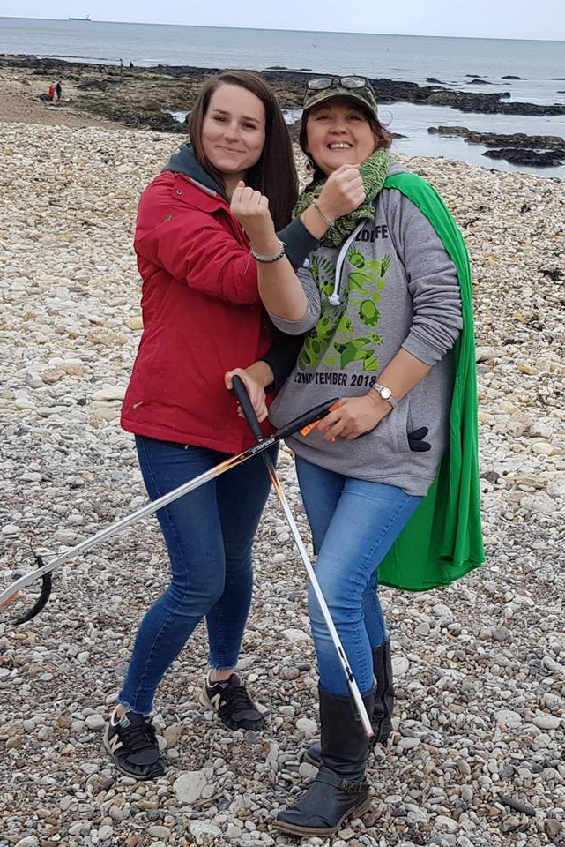
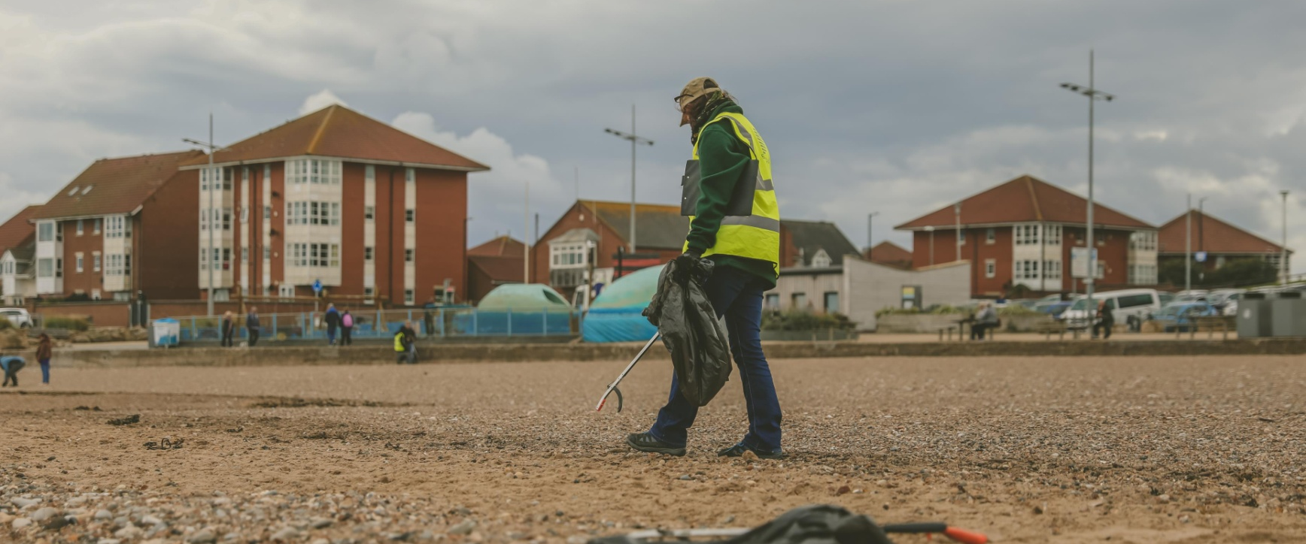
Beach Cleans

Slide 12
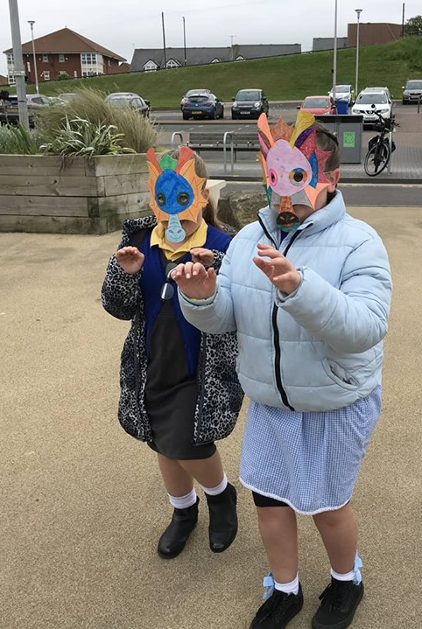
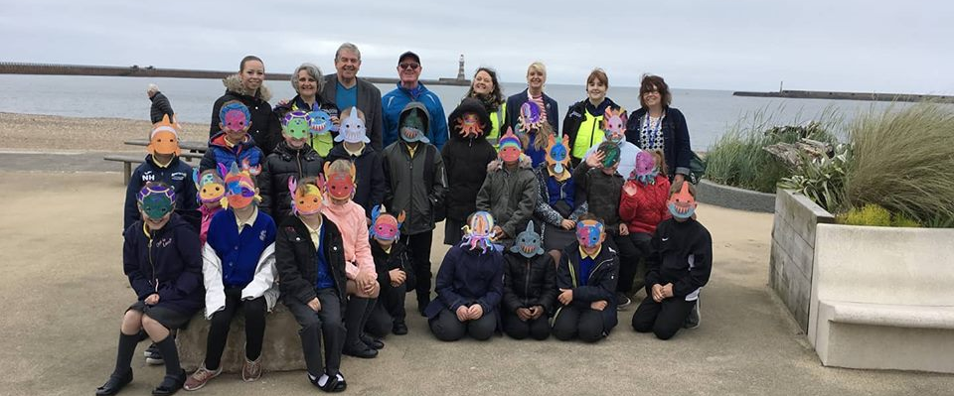
World Oceans Day 2018

Slide 13
Partnerships & Sponsors

Slide 14
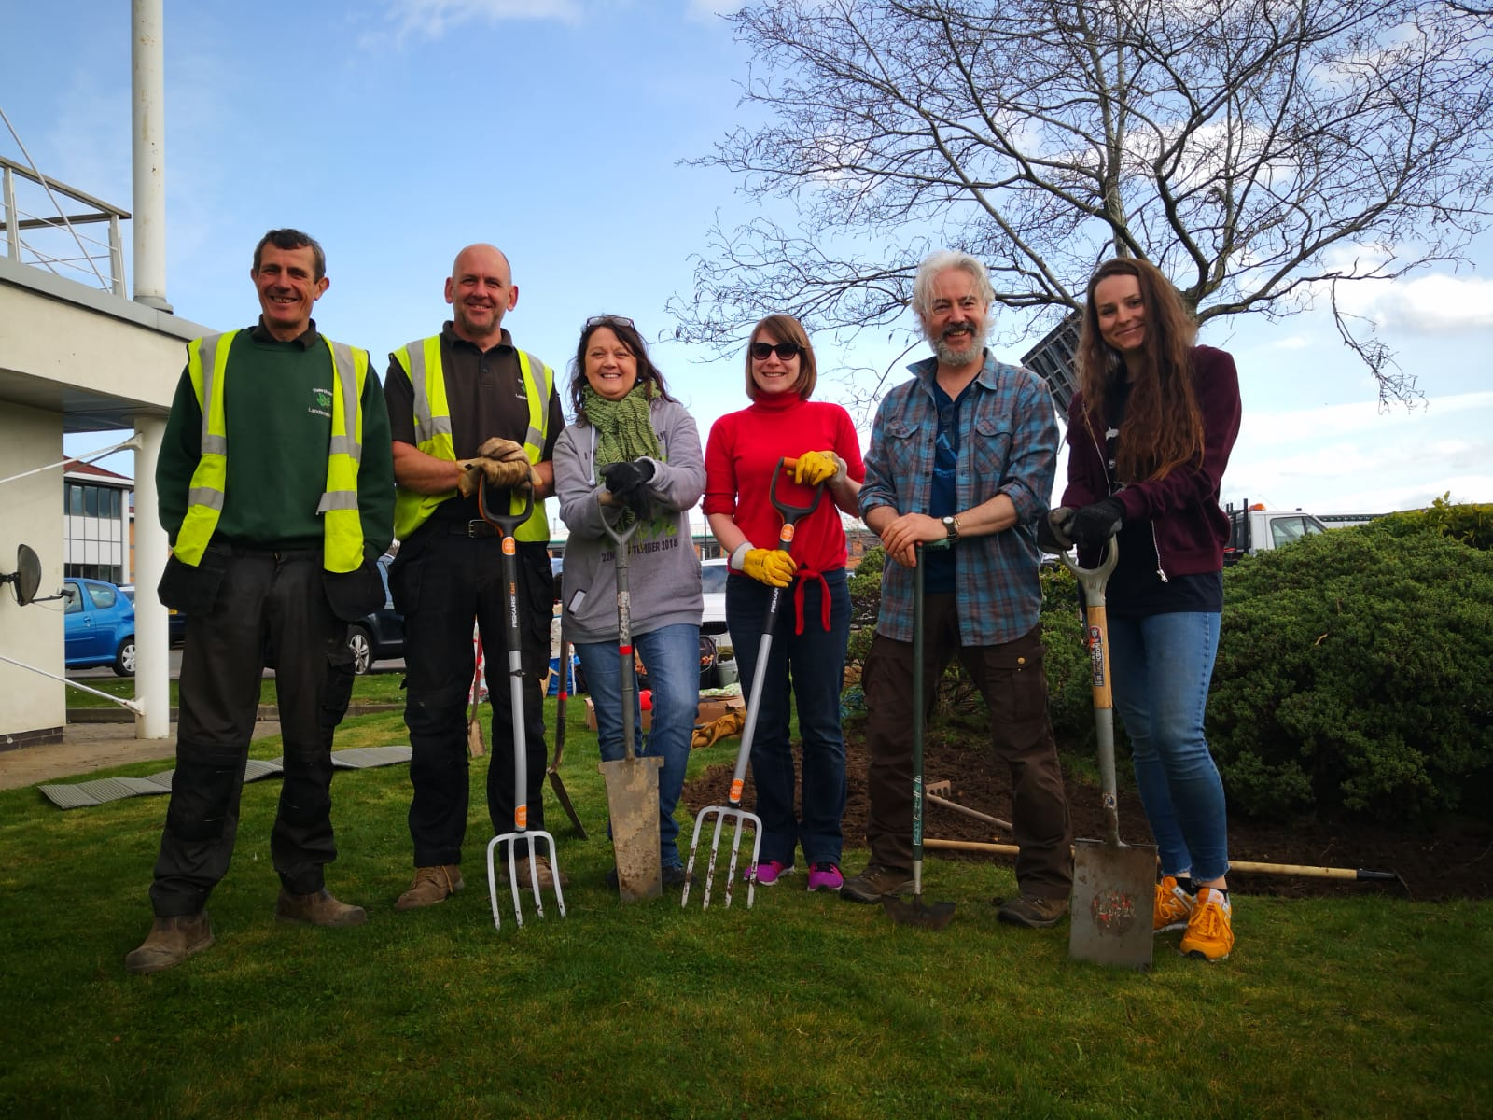
Pollinator Parks

Slide 15
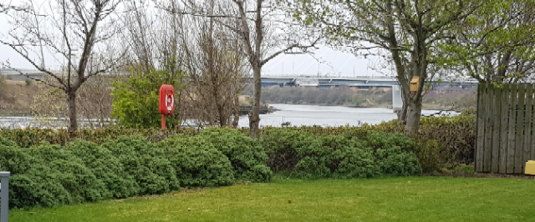
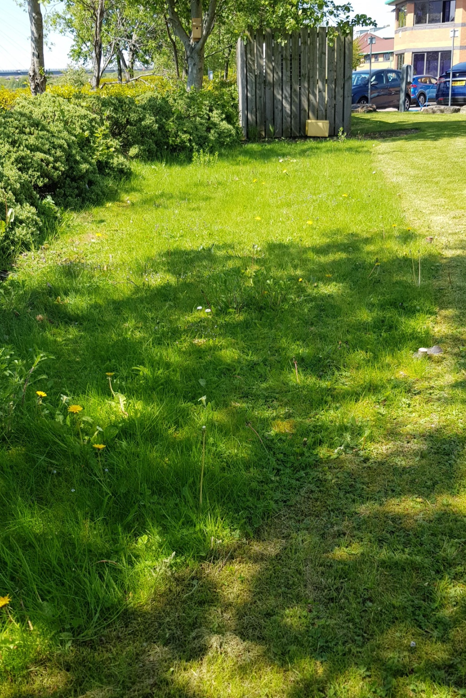
North East Business Innovation Centre

Slide 16
Pilot Project
Located behind Jupiter Building
10 x 3m unmown lawn
2 x Pollinator pods – dug out gardens east and west side
300 plants/plugs
Planted 21st March 2019

Slide 17
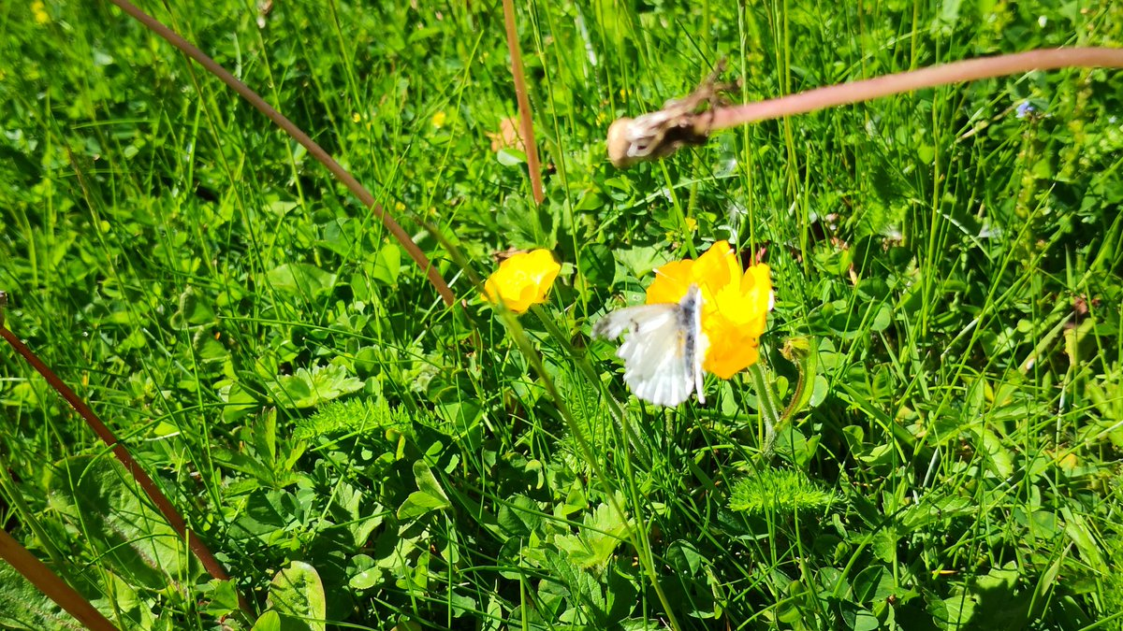
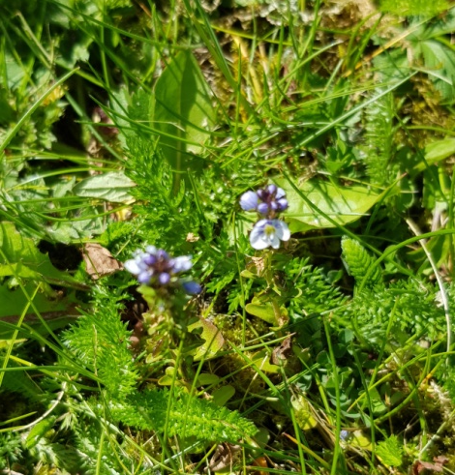
Plants List
Sunny Sides
(Nectar plants)
Basil
Birds Foot Trefoil
Coltsfoot
Cowslip
Greater Burnet
Kidney Vetch
Lady’s Bedstraw
Lesser Knapweed
Marjoram
Moth Mullien
Oxeye Daisy
Rough Hawkbit
Wild Clary
Shady Edge
Bugle
Lesser Celandine
(Colour Plants)
Betony
Cowslip
Devil’s Bit Scabious
Fox and Cubs (Orange Hawkbit)
Great Burnet
Maiden Pink
Meadow Cranesbill
Ragged Robin
Red Campion
Tansy
Vipers Bugloss
Wild Clary
Yellow Toadflax
Wild Lawn
Primrose (x2)
White clover
Meadow buttercup
Dandelion
Germander Speedwell
Tall
Common Mallow
Teasel
Foxglove
Generalists
Yellow rattle (seed and plant)
Dandelion
Herb Robert

Slide 18
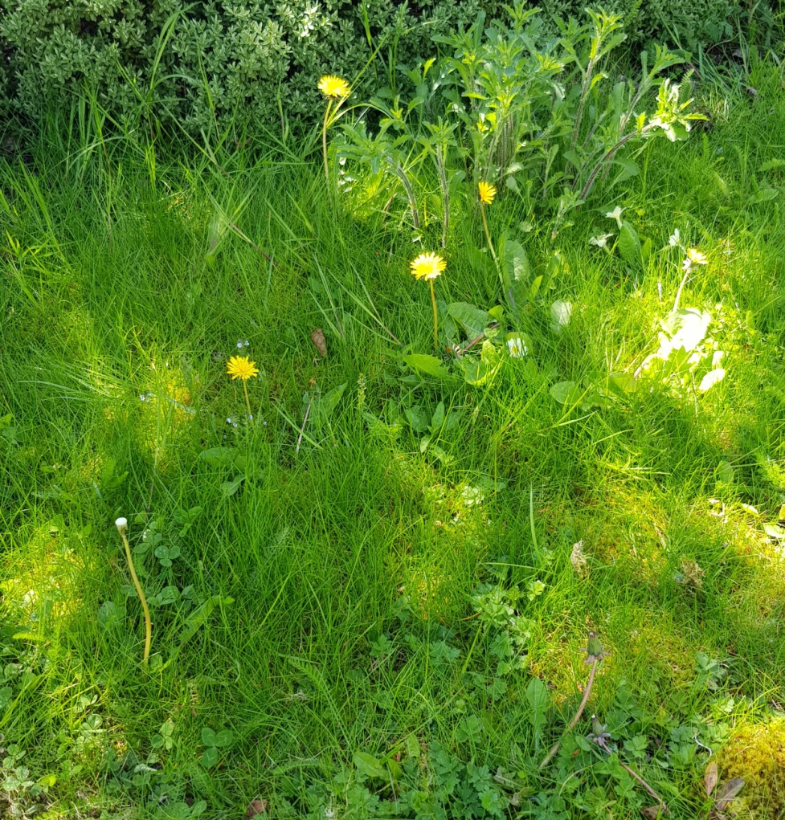
North East Business Innovation Centre

Slide 19
North East Business Innovation Centre

Slide 20
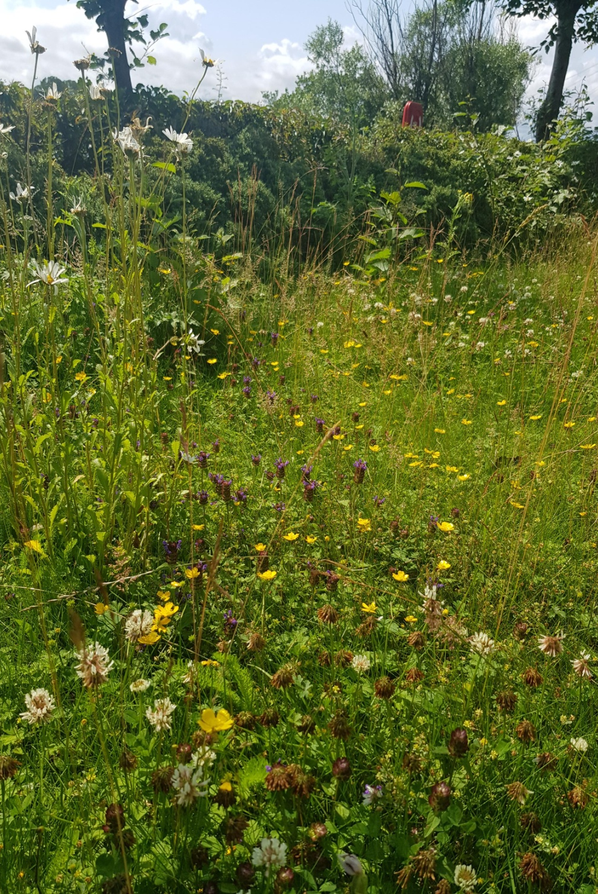
North East Business Innovation Centre

Slide 21
Challenges & Barriers
150 + tenants to keep happy
Educating tenants about “untidy” meadows and why we need pollinator gardens
Tenants say “why are we watering weeds!”
Educating tenants of the value of wasps

Slide 22
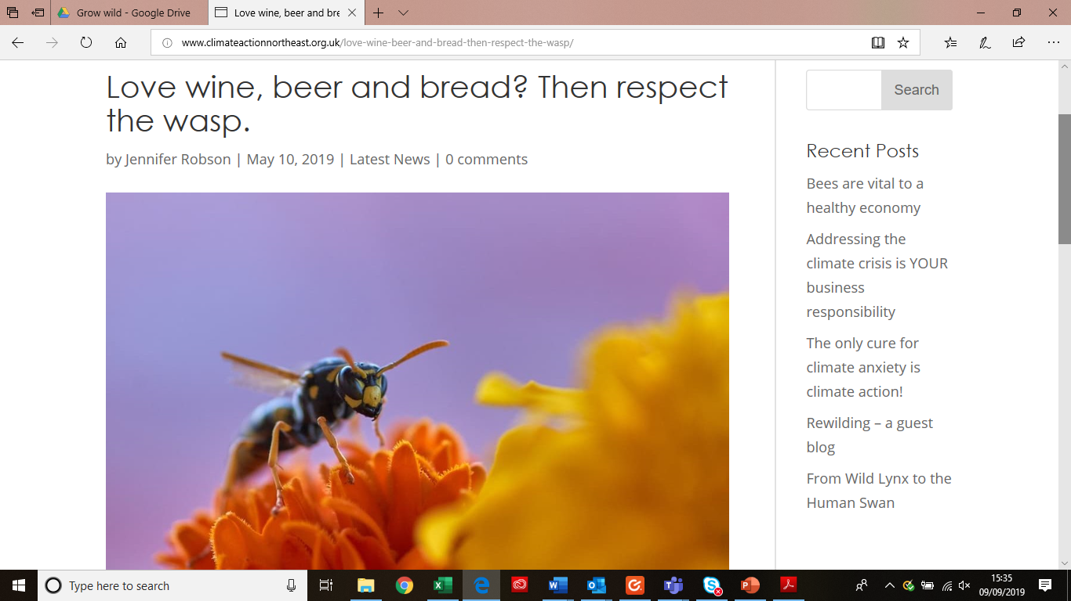
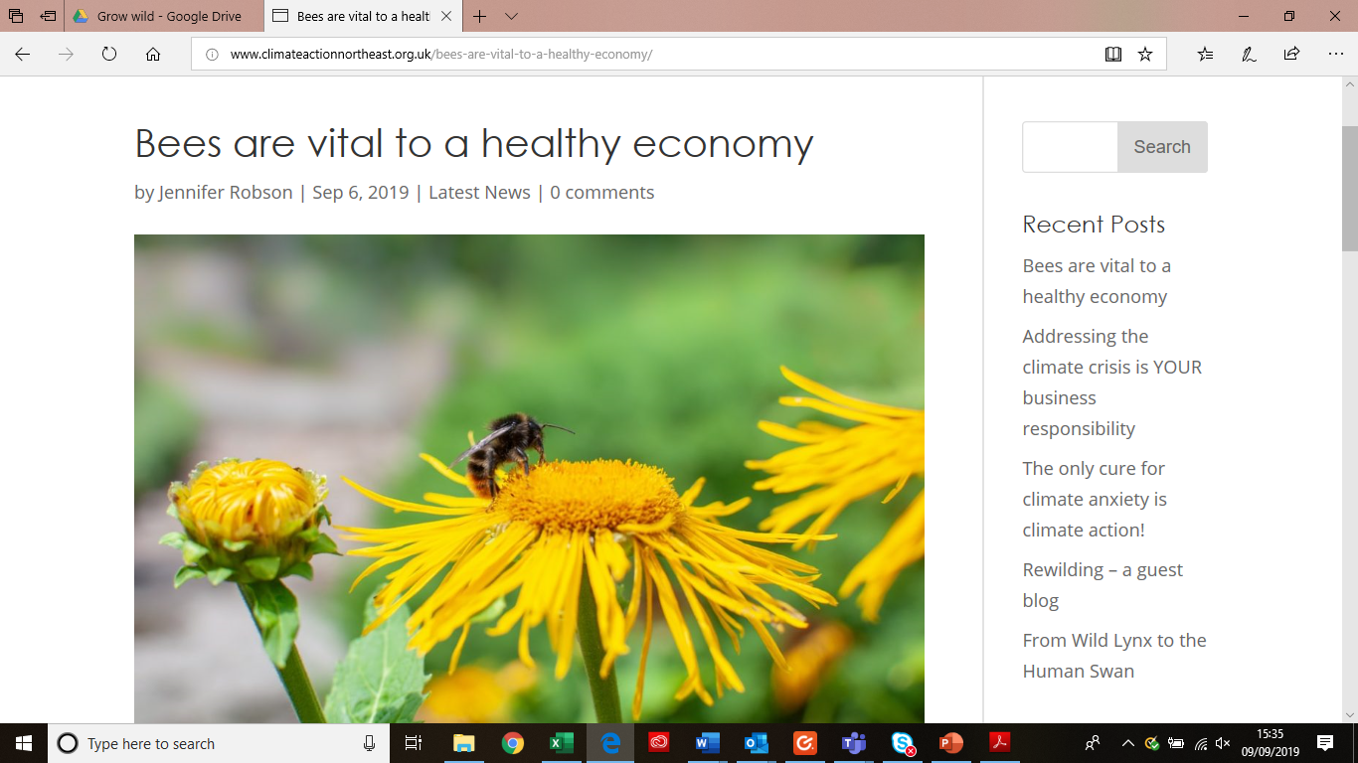
Blogs and Information

Slide 23
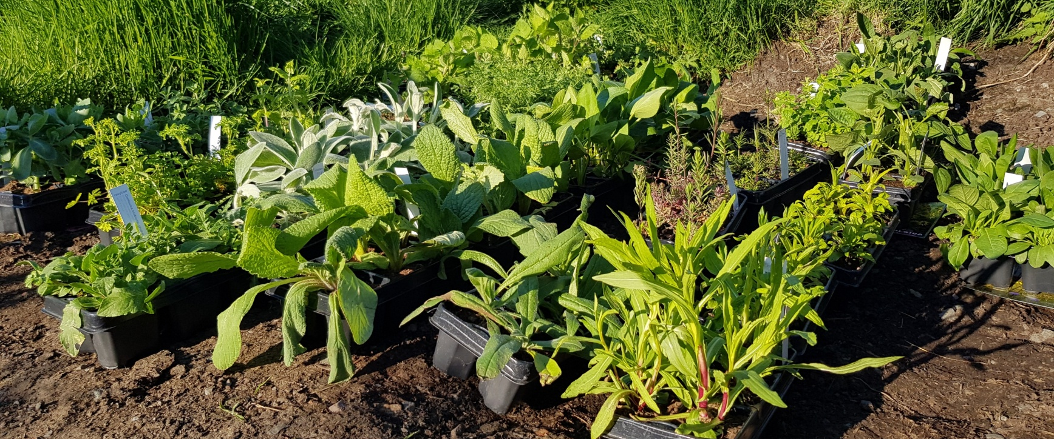
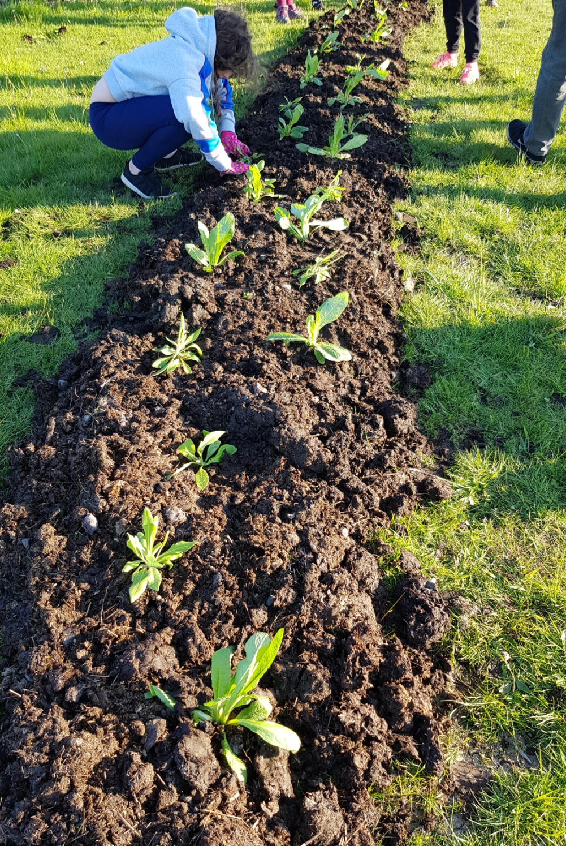
Grow Wild – Kew Garden Rewilding for Pollinators Maiden Wild

Slide 24
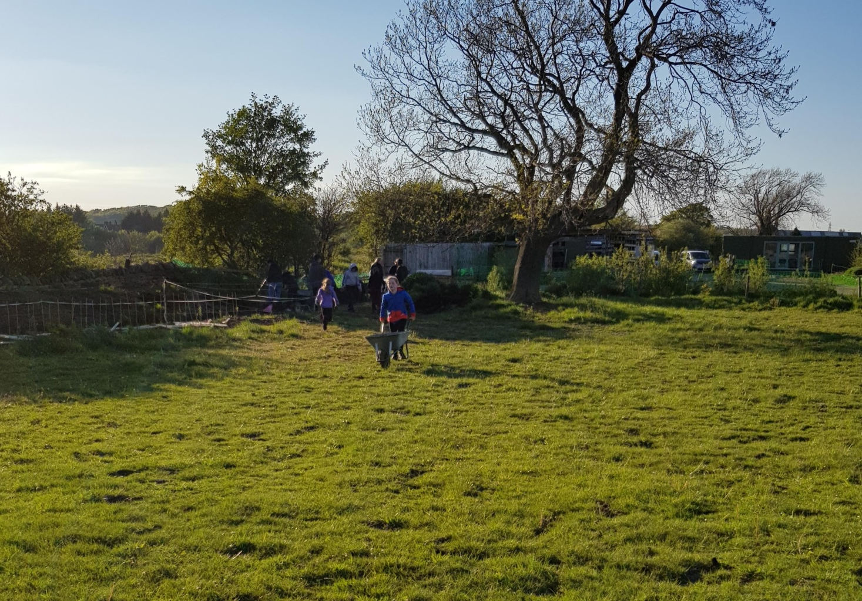
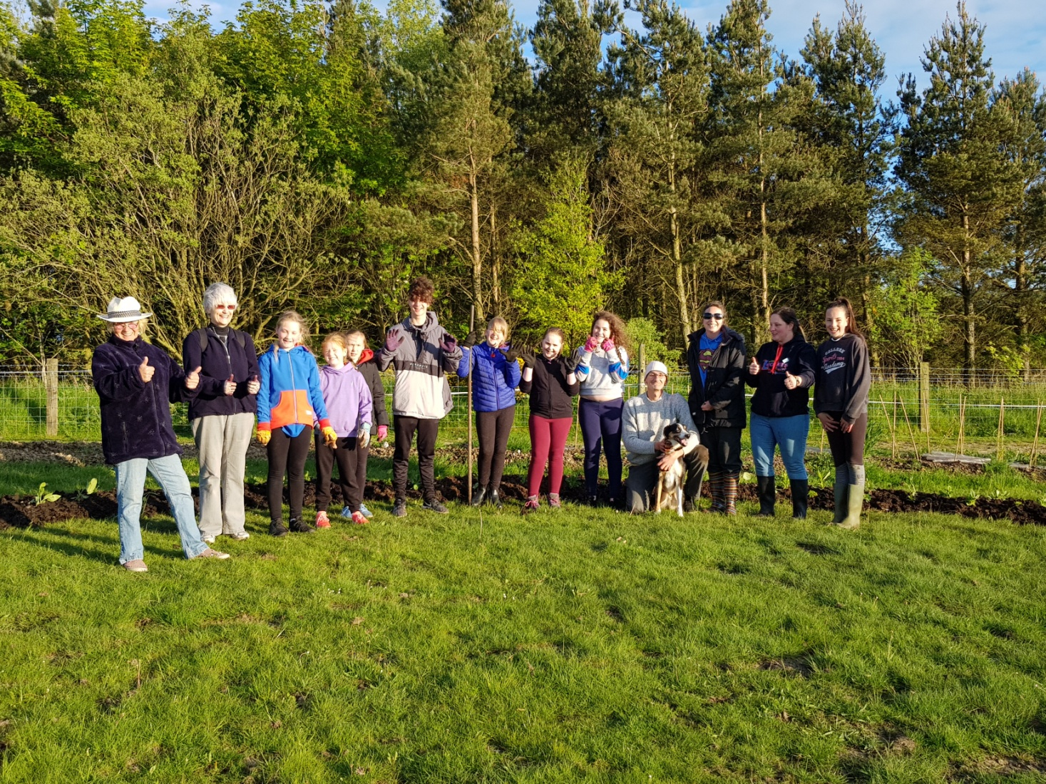
200 plants planted 16th May including, Borage, Comfrey, Devils Bit Scabious, Calamint, Solitary Bee, Honeybee mixes, Wildflower mix and native garden plants

Slide 25
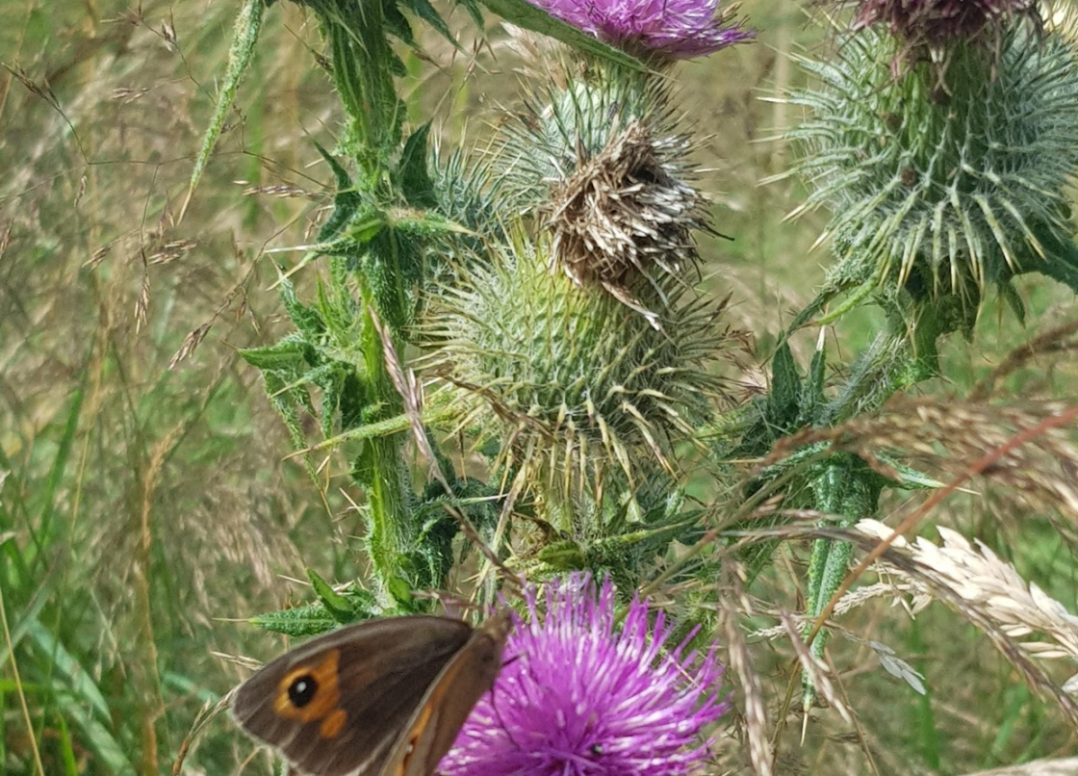
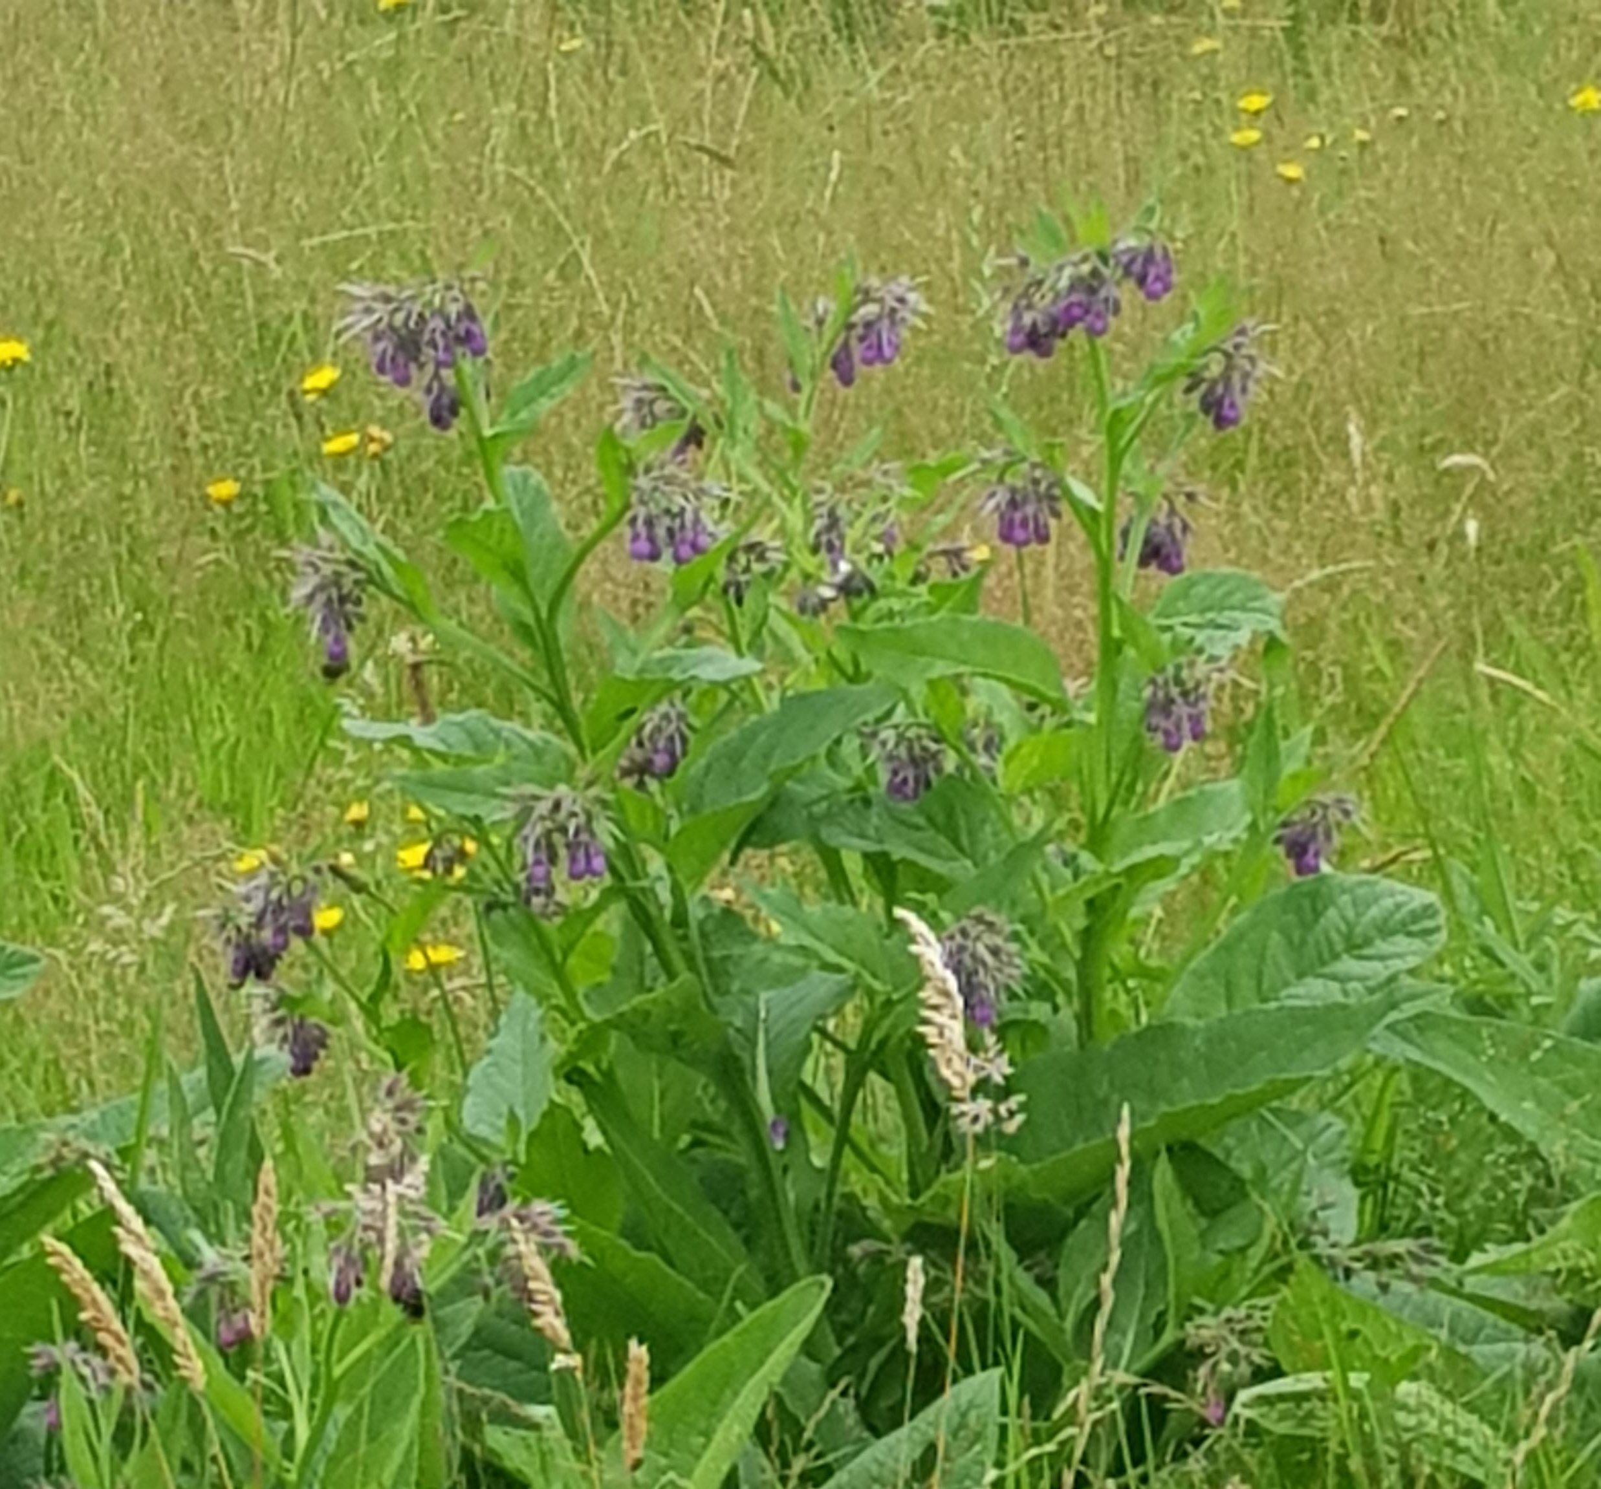
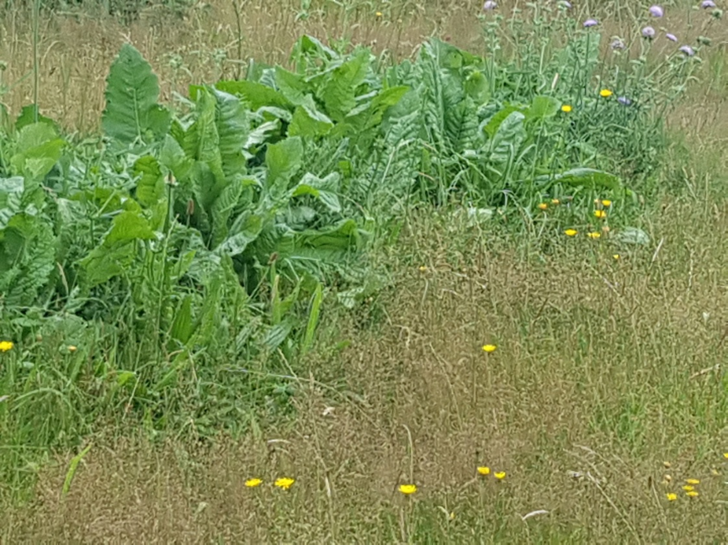

Slide 26
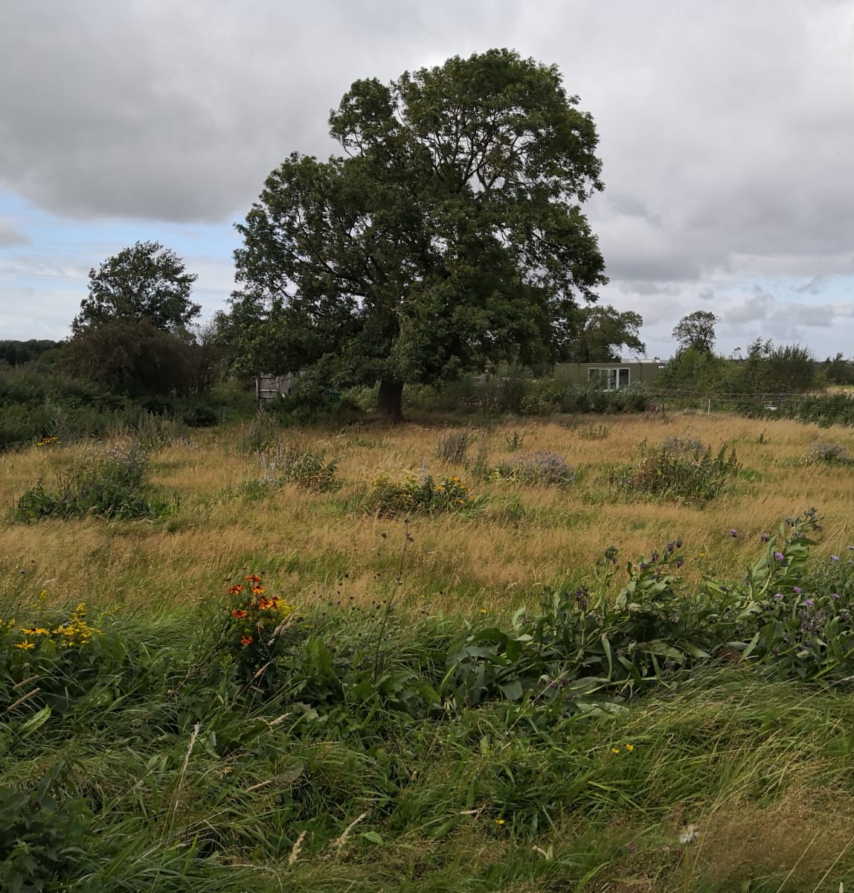
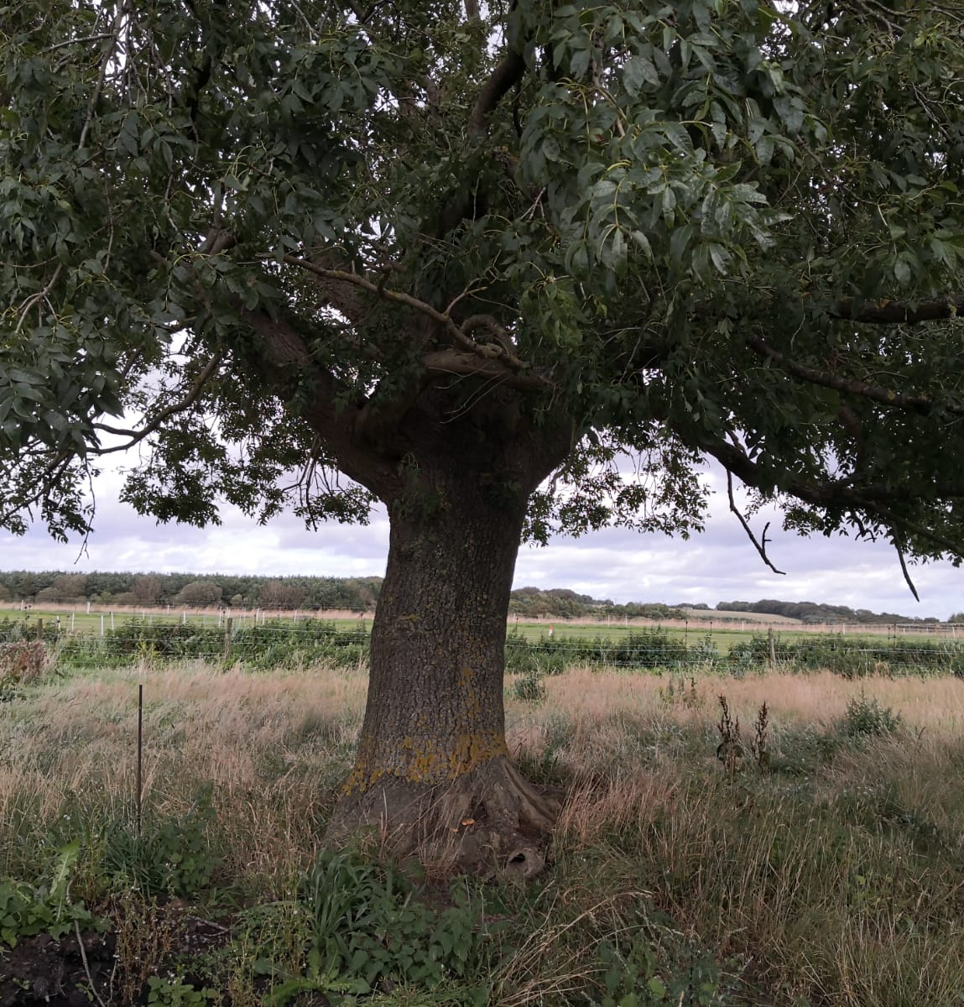
Bee Meadow is now a thriving haven for pollinators watched over by the Maiden Wild Ash tree

Slide 27
What’s next? Newton Aycliffe Business Park Darlington Business Central Dalton Park Team Valley Business Park Sunderland BIC – 2nd phase

Slide 28
Thank you Any Questions Sharon Lashley Email: Sharon@climateactionnortheast.org.uk

